Slide 1
What is more important for model calibration: information on the discharge dynamics or information on the discharge volume?
Navigation
Back to this slide
One slide backwards or forwards within a topic
?
Choose a topic
Franziska M. Clerc-Schwarzenbach,
Ilja van Meerveld, Marc Vis, Jan Seibert
2 min pitch
Short summary
Topic choice
Literature
franziska.clerc@geo.uzh.ch

Slide 2
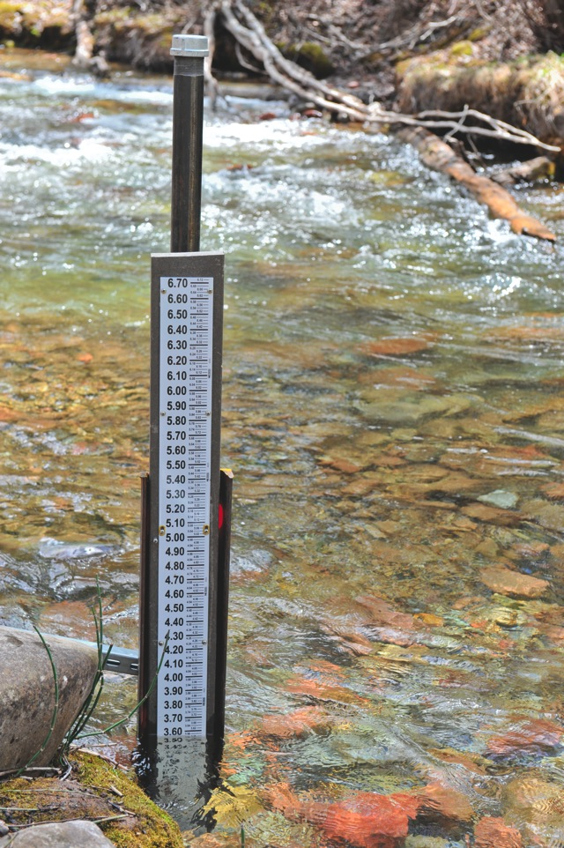
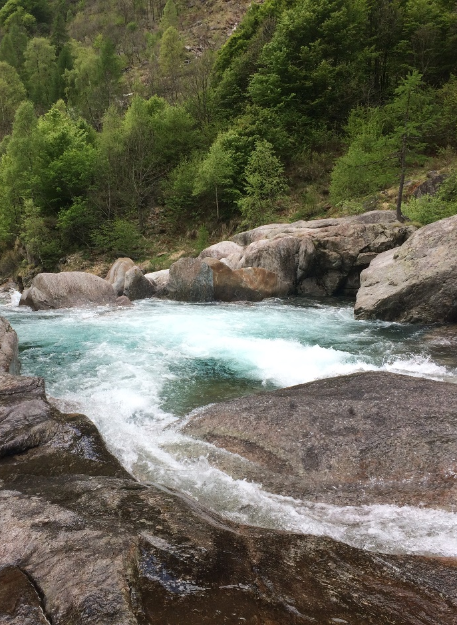
Large-sample hydrology for testing the value of data
~ 12 - 18 m³/s
or
Chris Council, Aspen Daily News
Private photo, Verzasca
Discharge dynamics
Discharge volume

Slide 3
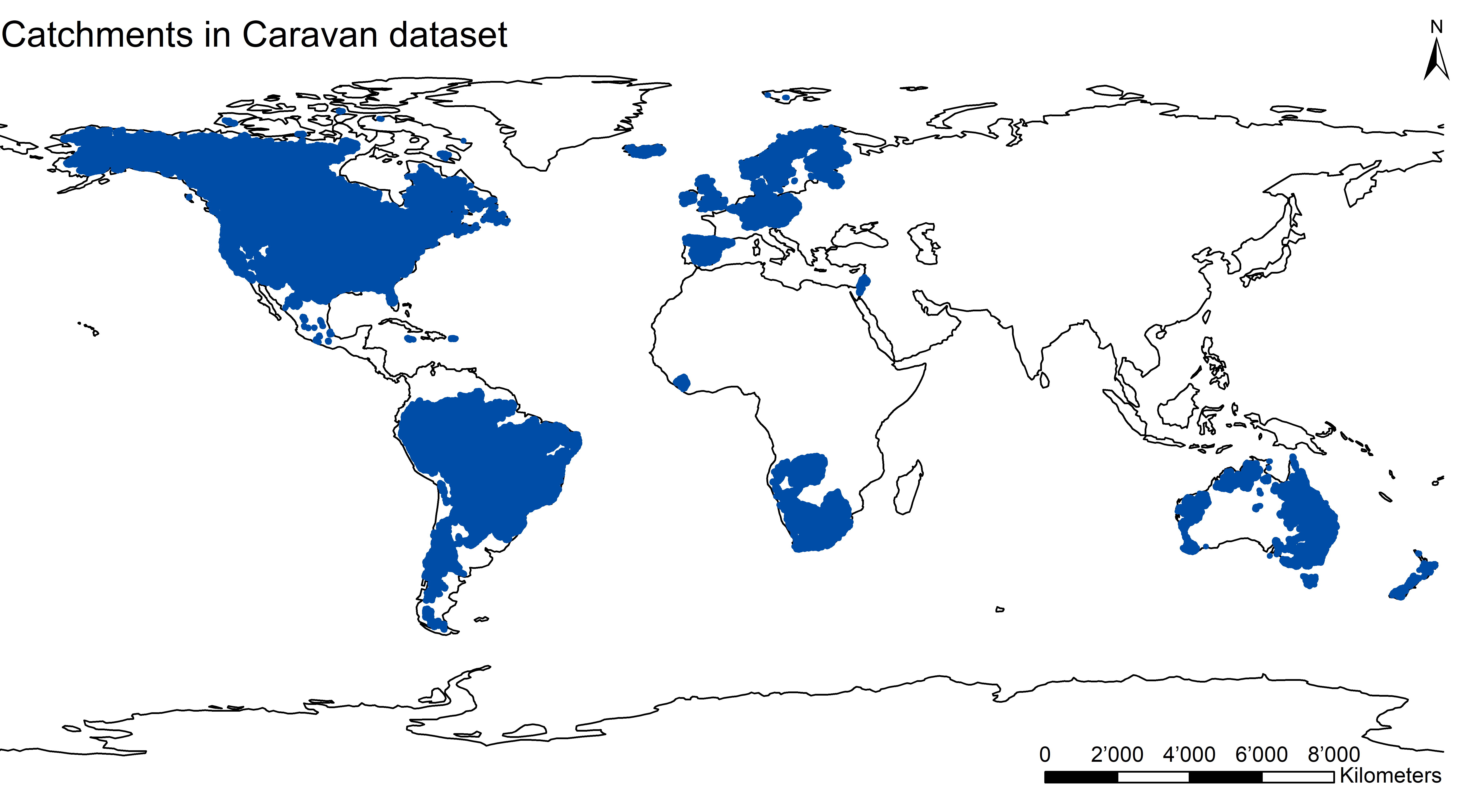
Large-sample hydrology for testing the value of data
~ 12 - 18 m³/s
or
Chris Council, Aspen Daily News
Private photo, Verzasca
Discharge dynamics
Discharge volume
Test with the Caravan dataset

Slide 4
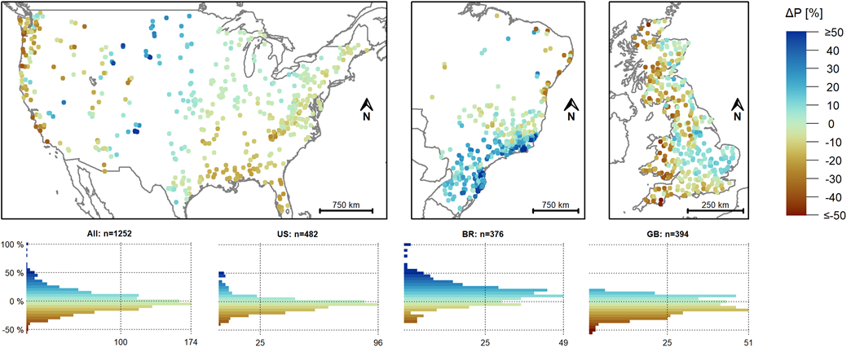
Caravan data compared to Camels data
Large differences in hydrometeorological data, especially for potential evapotranspiration and precipitation
naturalearthdata.com
Clerc-Schwarzenbach et al. (in review):
HESS Opinions: A few camels or a whole caravan?

Slide 5
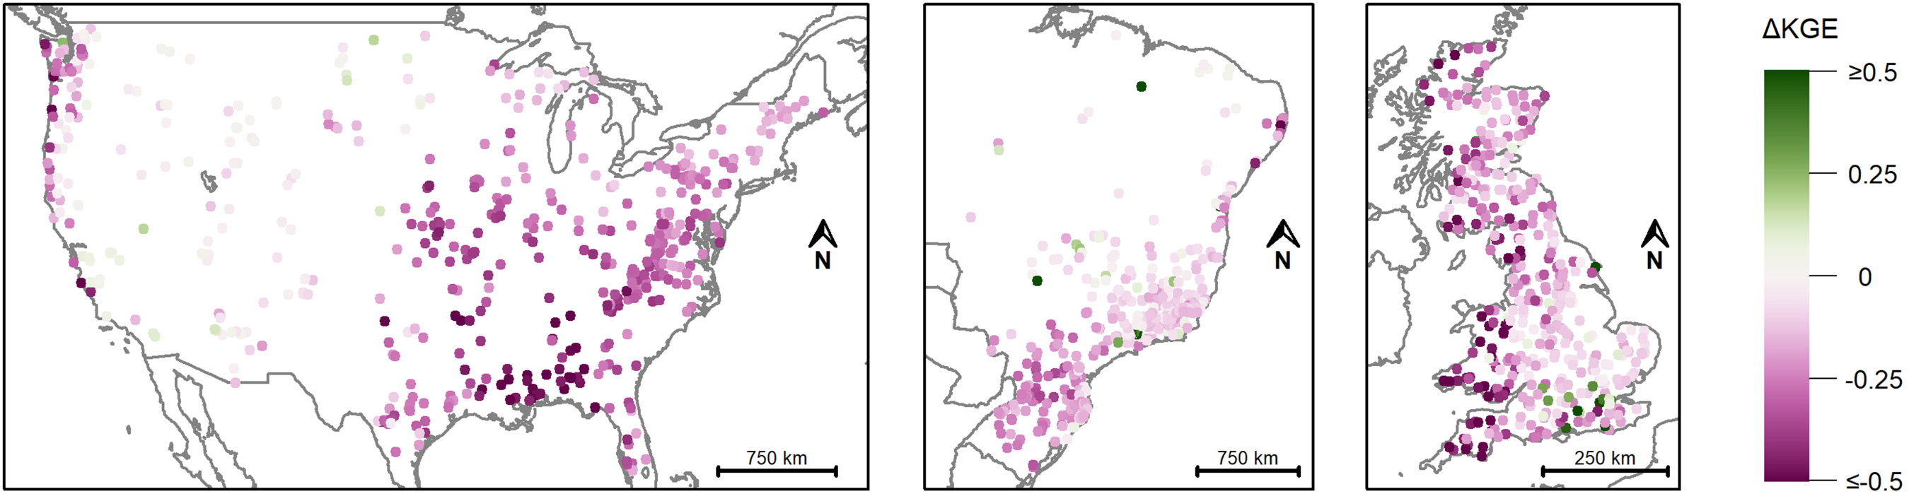
Caravan data compared to Camels data
Large differences in hydrometeorological data, especially for potential evapotranspiration and precipitation
naturalearthdata.com
Considerable difference in model performance depending on the data used for model calibration
Clerc-Schwarzenbach et al. (in review):
HESS Opinions: A few camels or a whole caravan?

Slide 6
Choose your question: part I
Why are you only using US catchments and not the Caravan dataset?
Why only CAMELS?
How are you assessing the value of information on discharge dynamics and volume for model calibration?
Methods
Why are you assessing the value of data?
Motivation
Have there been similar studies?
Earlier results

Slide 7
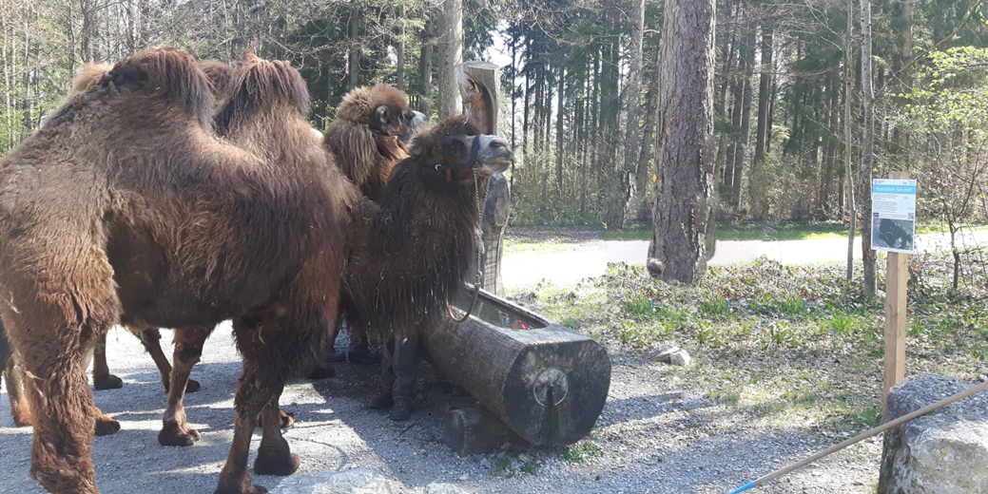
Choose your question: part II
What is the value of information on discharge dynamics, volume, or both?
Results
Do the results differ for different performance measures?
NSE and KGE
What do the performances mean in terms of simulated hydrographs and constraining parameter values?
Behind the scenes
Where can I find more about your work?
Literature
And the real camels?

Slide 8
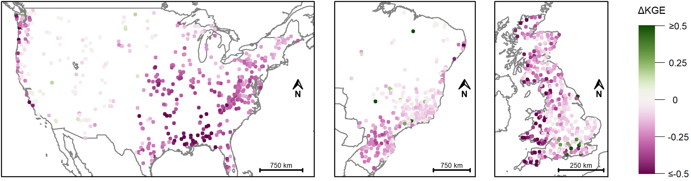
Summary
?
Pre-study comparing the Caravan dataset with CAMELS, CAMELS-BR, and CAMELS-GB
Considerable loss in data quality due to the standardized meteorological forcing data
Why only CAMELS?
Clerc-Schwarzenbach et al. (in review):
HESS Opinions: A few camels or a whole caravan?

Slide 9
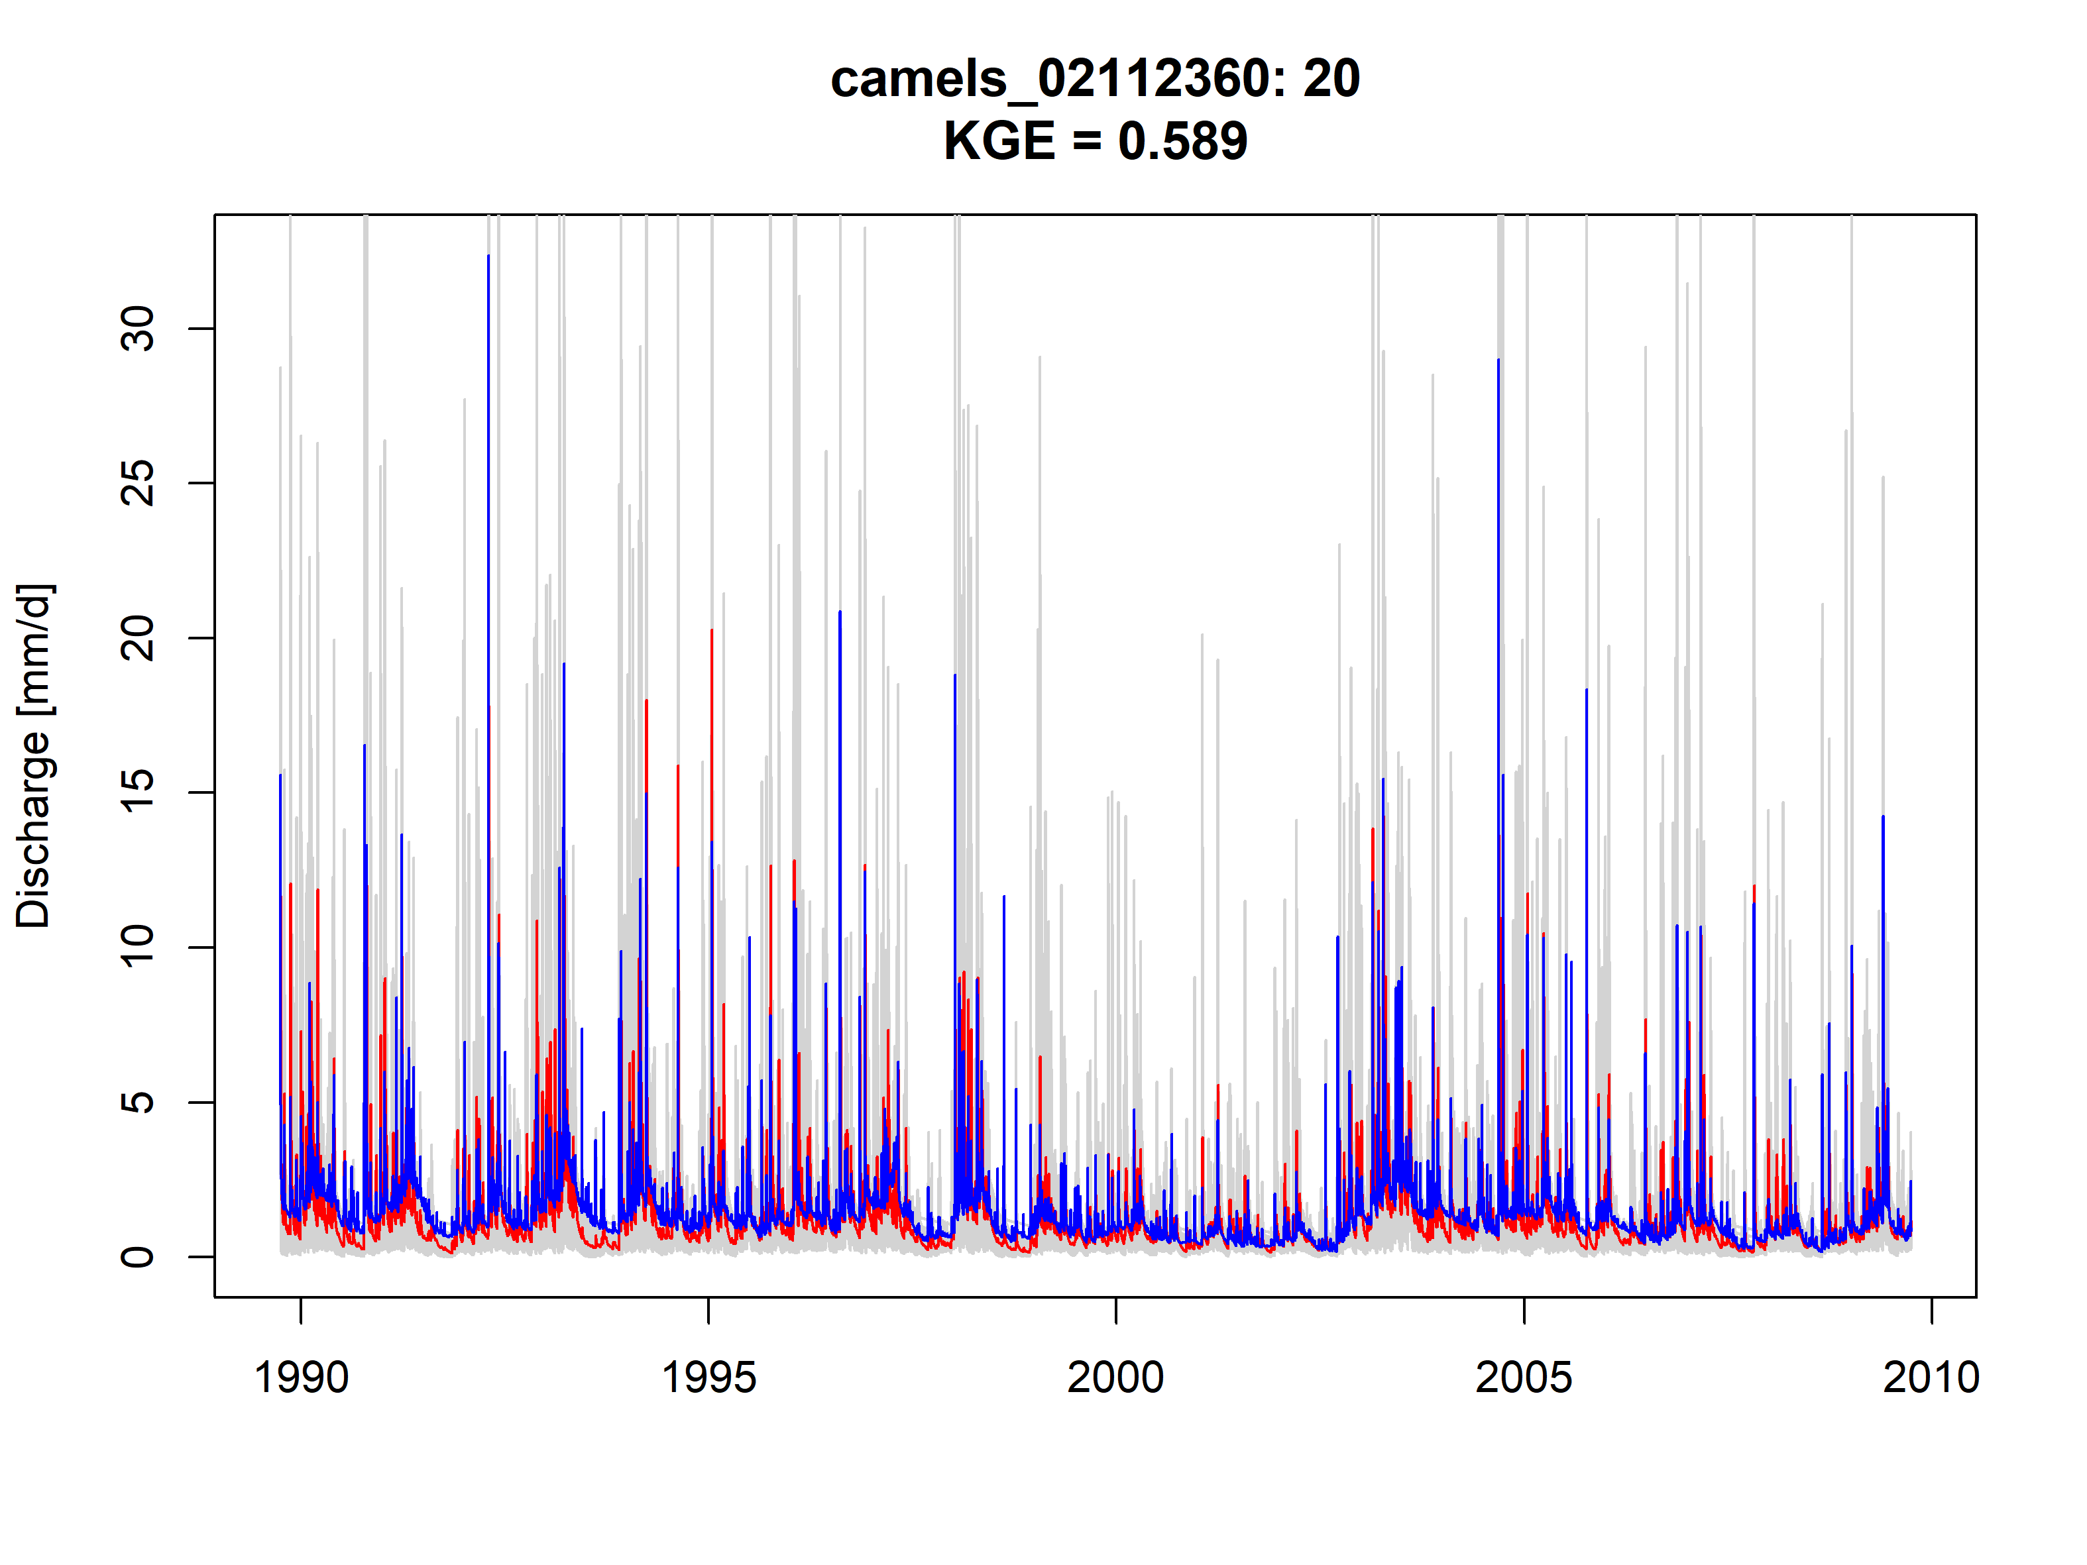
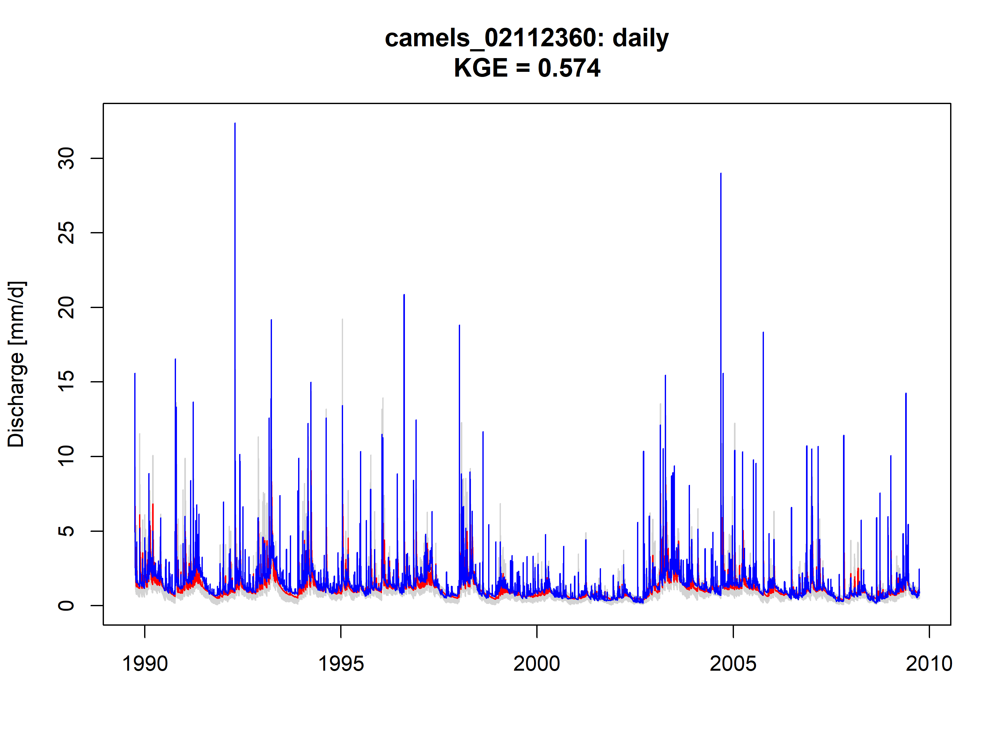
Summary
?
Determine the value of information on discharge dynamics and discharge volume for hydrological model calibration for catchments with different characteristics (e.g., aridity)
So far: Similar performances, but stronger constraint from dynamics; but results depend on the performance measure used
±20 % of the actual mean discharge
daily stream levels
Results

Slide 10
Why CAMELS instead of Caravan?
?
Considerable model performance drop due to use of Caravan forcing data (compared to CAMELS, CAMELS-BR, CAMELS-GB)
Mainly due to differences in precipitation data
naturalearthdata.com
Clerc-Schwarzenbach et al. (in review):
HESS Opinions: A few camels or a whole caravan?

Slide 11
Differences in precipitation
?
Difference in mean annual precipitation, 1983-2013
$$∆P=\frac{\overline{P_{Camels}}−\overline{P_{Caravan}}}{\overline{P_{Camels}}}$$
naturalearthdata.com
Clerc-Schwarzenbach et al. (in review):
HESS Opinions: A few camels or a whole caravan?

Slide 12
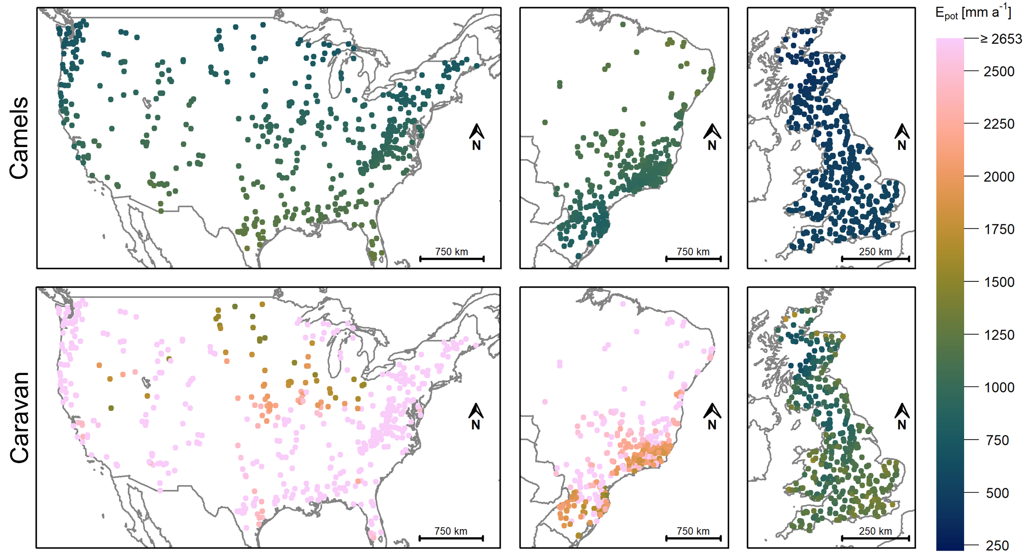
Issues with potential evapotranspiration
?
Overestimation of potential evapotranspiration (based on ERA5-Land) in the Caravan dataset
Moderate effect of the evapotranspiration data on model performance, but clearly unrealistic values
naturalearthdata.com
Clerc-Schwarzenbach et al. (in review):
HESS Opinions: A few camels or a whole caravan?

Slide 13
Tests with different forcing data
?
Scenario | Precipitation | Temperature | Potential evapotranspiration
I
II
III
IV
V
VI
VII
Camels
Camels
Camels
Caravan
Caravan
Caravan
Caravan
Camels
Camels
Camels
Caravan
Camels
Camels
Camels
Caravan
Camels
Camels
Alternative for Caravan
Caravan
Caravan
Alternative for Caravan
Clerc-Schwarzenbach et al. (in review):
HESS Opinions: A few camels or a whole caravan?

Slide 14
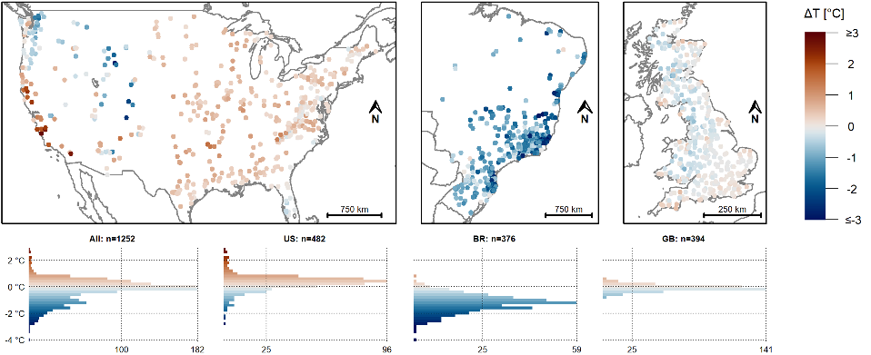
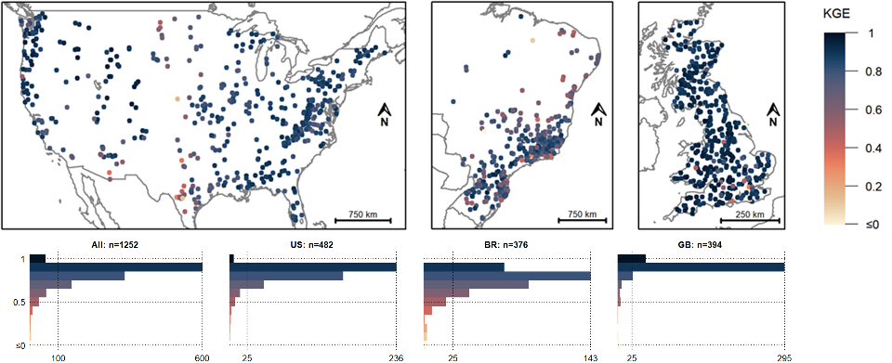
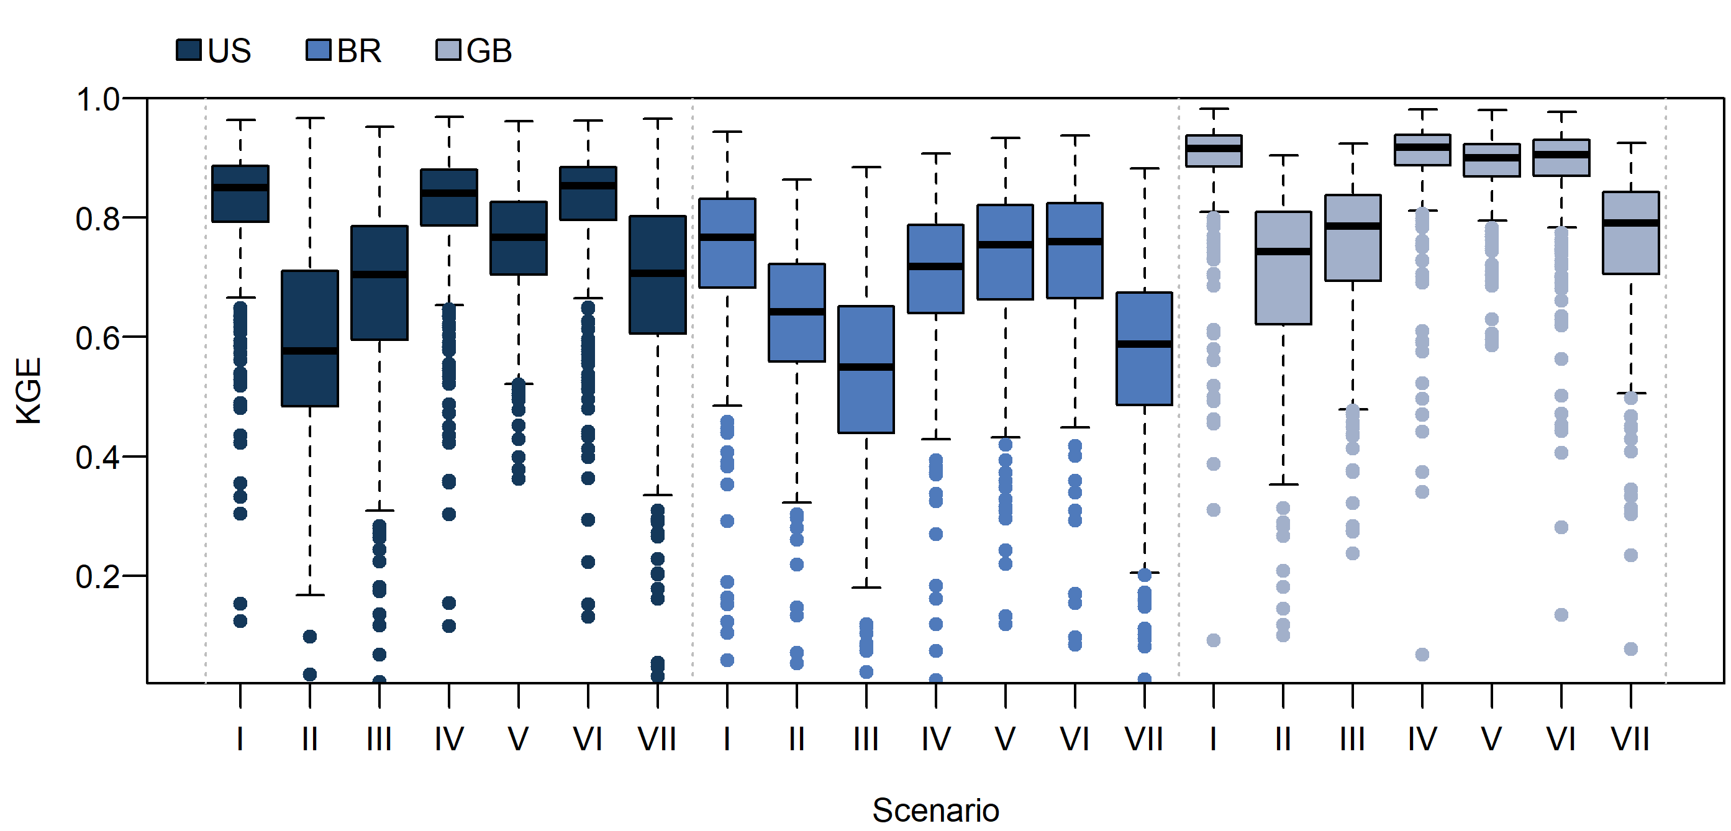
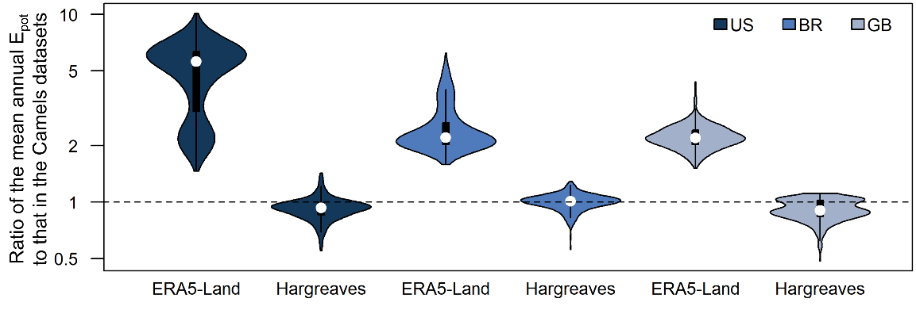
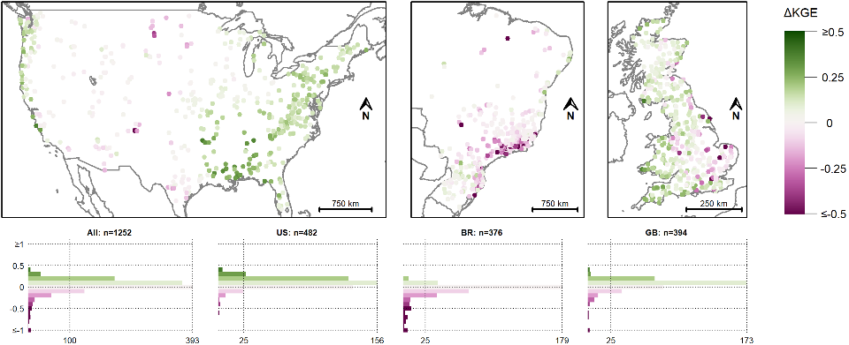
More results (click to enlarge)
?
Differences in temperature
Model performance Camels
All forcing data combinations
Aridity index Camels and Caravan
Alternative E_{pot} data
Effect of alternative E_{pot} data
Clerc-Schwarzenbach et al. (in review):
HESS Opinions: A few camels or a whole caravan?

Slide 15
Differences in temperature
?
naturalearthdata.com
Clerc-Schwarzenbach et al. (in review):
HESS Opinions: A few camels or a whole caravan?

Slide 16
Model performance Camels
?
naturalearthdata.com
Clerc-Schwarzenbach et al. (in review):
HESS Opinions: A few camels or a whole caravan?

Slide 17
All forcing data combinations
?
I: All Camels
II: All Caravan
III: Camels, precipitation Caravan
IV: Camels, temperature Caravan
V: Camels, E_{pot} Caravan
VI: Camels, alternative E_{pot}
VII: Caravan, alternative E_{pot}
Clerc-Schwarzenbach et al. (in review):
HESS Opinions: A few camels or a whole caravan?

Slide 18
Aridity index: Camels and Caravan
?
Clerc-Schwarzenbach et al. (in review):
HESS Opinions: A few camels or a whole caravan?

Slide 19
Alternative E_{pot} data (Hargreaves-based)
?
Calculation of alternative E_{pot} data according to Adam et al. (2006): Hargreaves-Samani equation with monthly precipitation sums as a humidity proxy
Clerc-Schwarzenbach et al. (in review):
HESS Opinions: A few camels or a whole caravan?

Slide 20
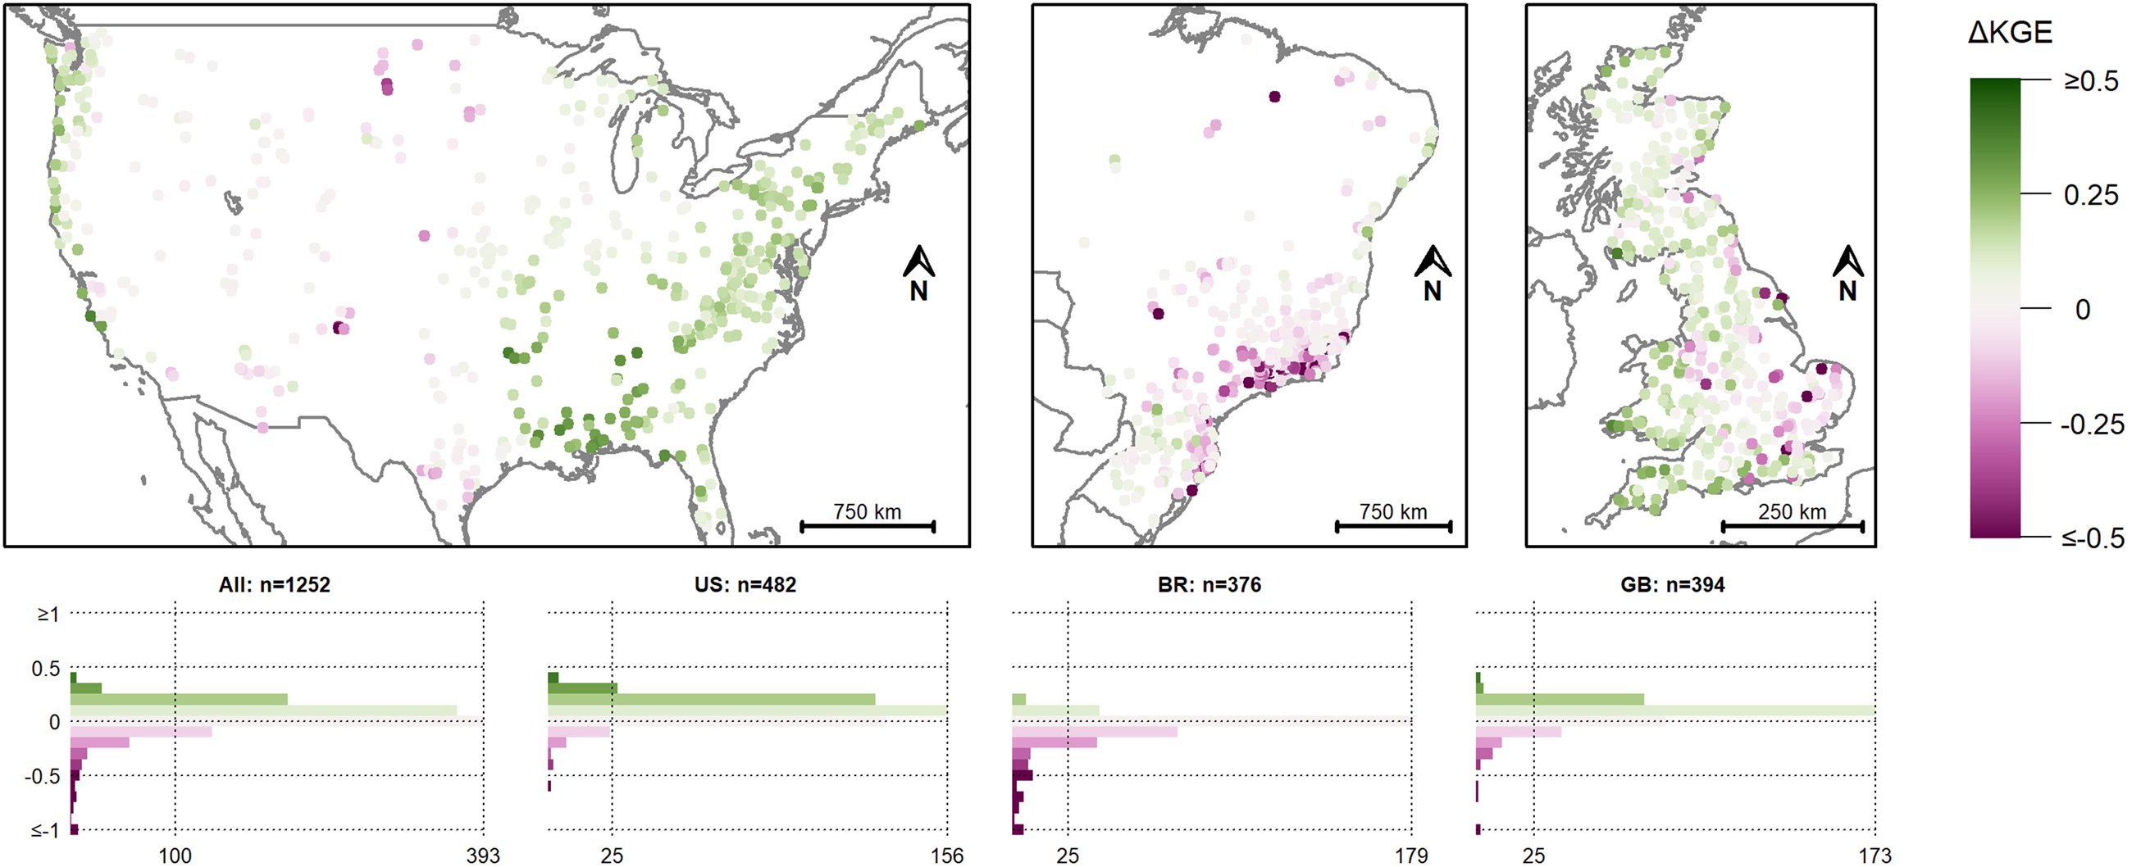
Alternative E_{pot} data effect
?
naturalearthdata.com
Clerc-Schwarzenbach et al. (in review):
HESS Opinions: A few camels or a whole caravan?

Slide 21
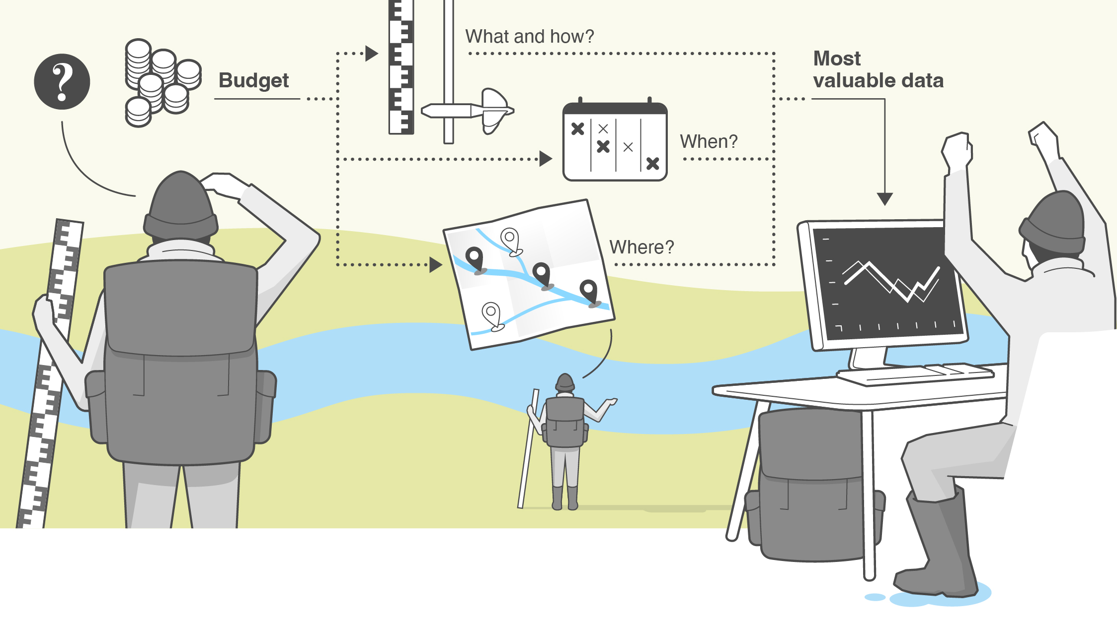
Motivation
?
Lack of data in the environmental sciences in general and in hydrology in particular
Assessment of the value of certain data types, measurement schedules, and locations for an effective allocation of resources
Test in catchments with a lot of data to gain knowledge for ungauged catchments
© Mathias Bader, MELS, University of Zurich
Seibert et al. (2024): Getting your money’s worth: Testing the value of data for hydrological model calibration. Hydrol. Process.

Slide 22
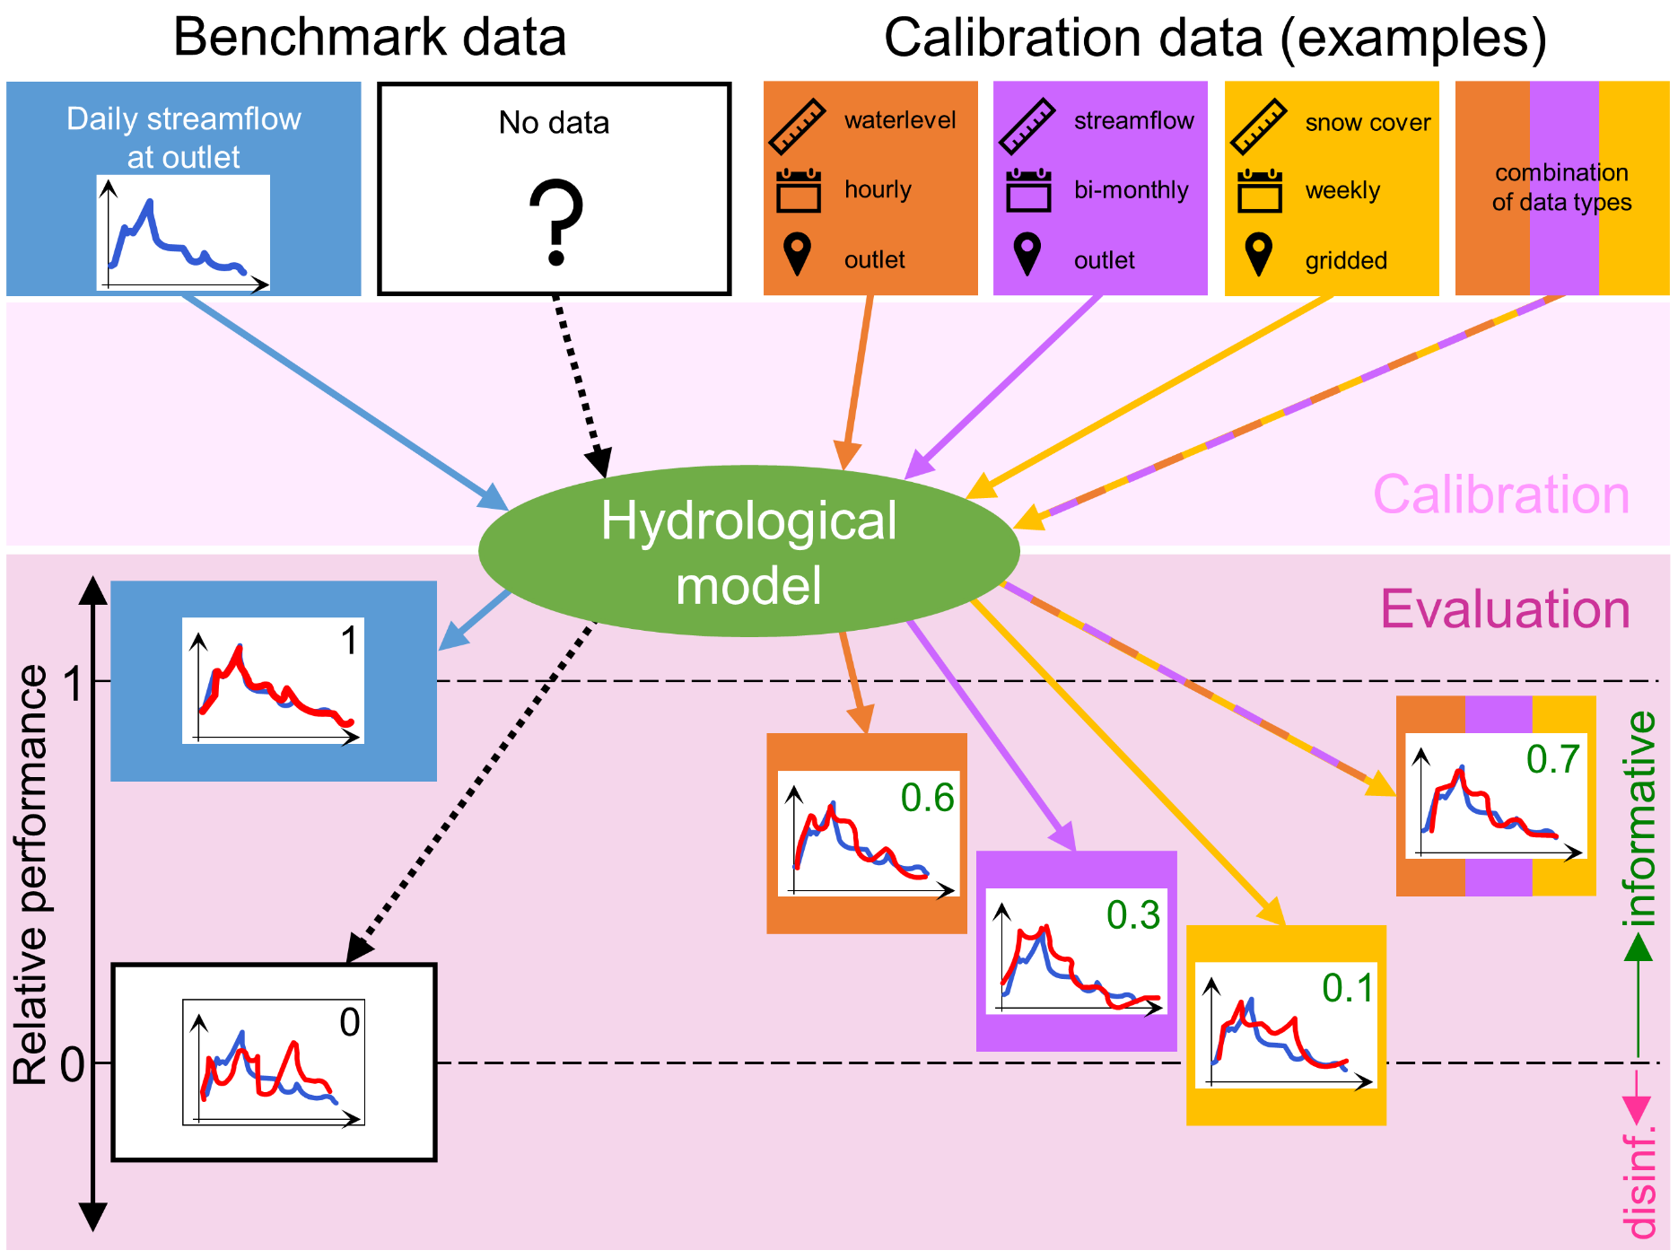
Assessing the value of data
?
Model calibration with limited / alternative data (e.g., waterlevel data or mean discharge estimates)
Evaluation of the achieved model performance compared to an upper and a lower benchmark
Seibert et al. (2018)
Calibration data are informative if resulting model performance is better than the use of random parameter sets (lower benchmark)
Seibert et al. (2024): Getting your money’s worth: Testing the value of data for hydrological model calibration. Hydrol. Process.

Slide 23
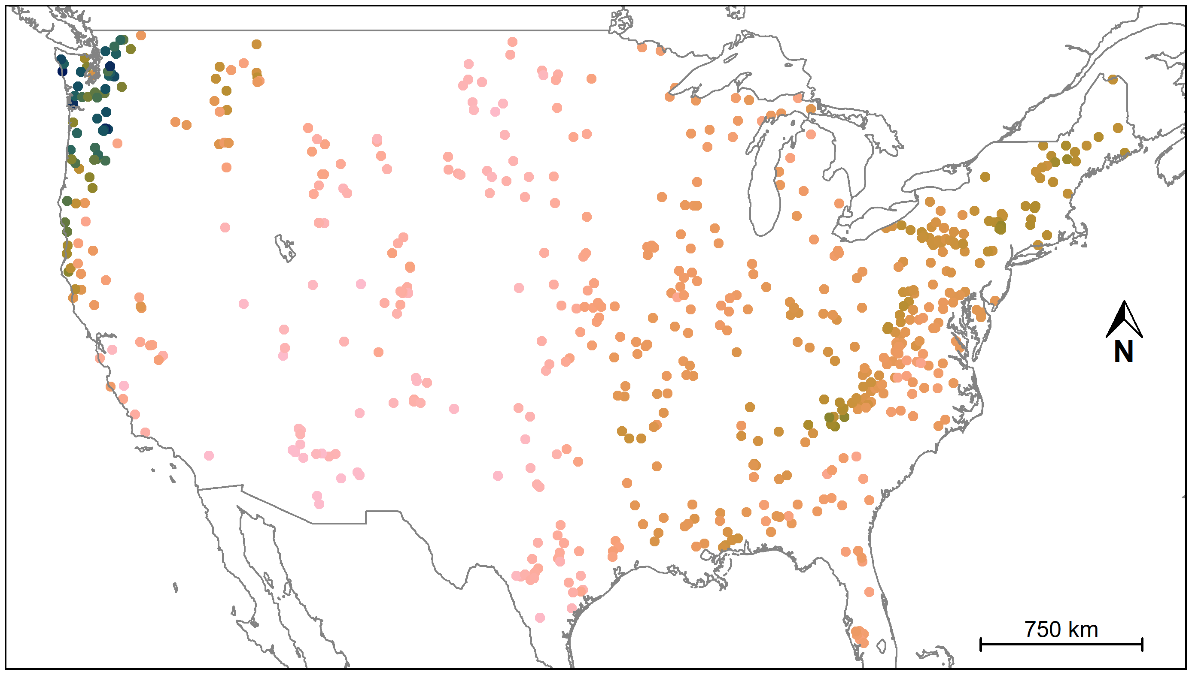
Study catchments
?
606 catchments from CAMELS
Newman et al. (2015)
Addor et al. (2017)
62 of 671 catchments excluded due to discrepancies in the area
3 of 671 catchments excluded due to more than 365 missing discharge data points (10/1989-09/2009)
naturalearthdata.com
Why only CAMELS?

Slide 24
Test data
?
Combinations
±1 %
±2 %
±3 %
daily
±4 %
±5 %
±10 %
±15 %
Discharge dynamics
±20 %
Discharge volume
weekly
±25 %
±30 %
(stream levels)
±35 %
(range around mean discharge)
±40 %
monthly
±45 %
±50 %
±75 %
±100 %

Slide 25
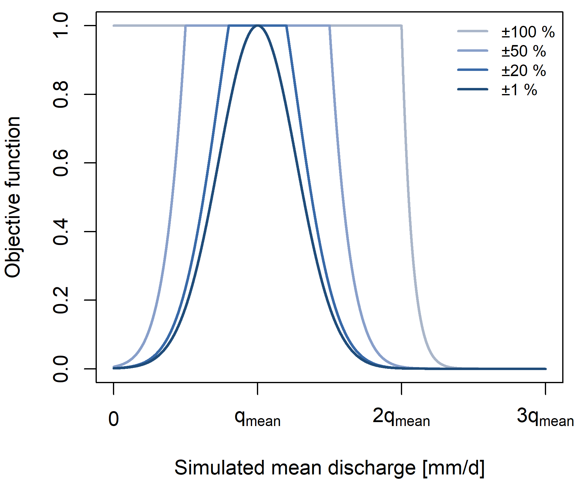
Model calibration
?
HBV model; calibration period: 10/1989-09/2009, also used for evaluation
Calibration based on discharge dynamics: Spearman rank correlation as objective function
Seibert & Vis (2016); van Meerveld et al. (2017)
Calibration based on discharge volume: objective function taking only mean discharge into account
Calibration based on both data types: equal weights
Equifinality: 100 calibrations with a genetic algorithm

Slide 26
Model evaluation
?
Evaluation of the ensemble mean discharge of 100 calibrated parameter sets
Non-parametric efficiency (NPE) as performance measure
Pool et al. (2018)
Evaluation of the achieved model performance compared to an upper and a lower benchmark
Seibert et al. (2018)
Flow-duration
curve
NPE
Spearman rank
correlation
Mean
discharge

Slide 27
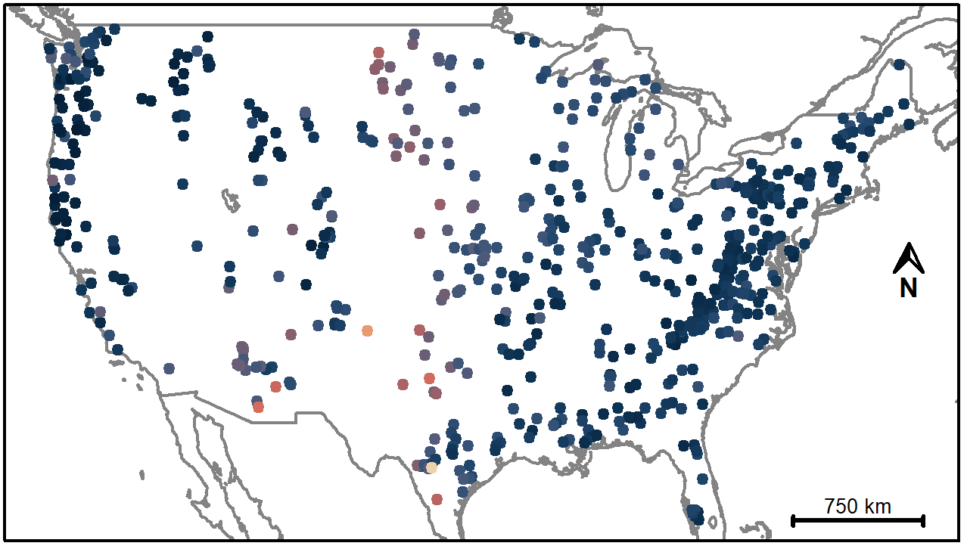
Results: upper benchmark
?

Slide 28
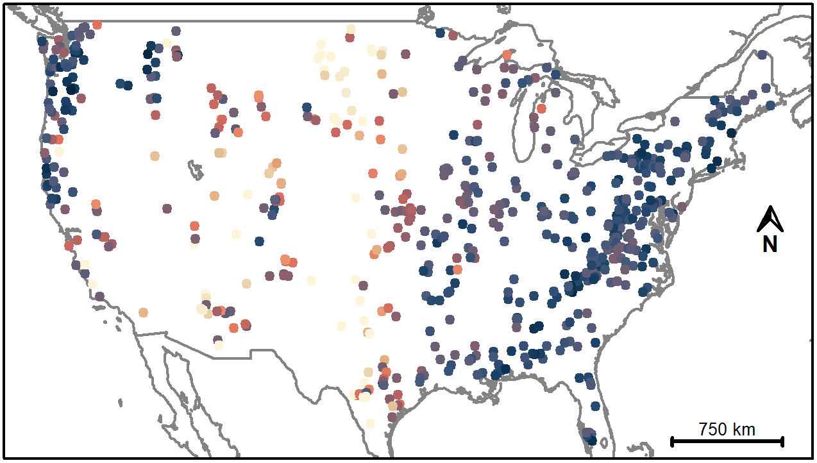
Results: daily stream levels
?

Slide 29
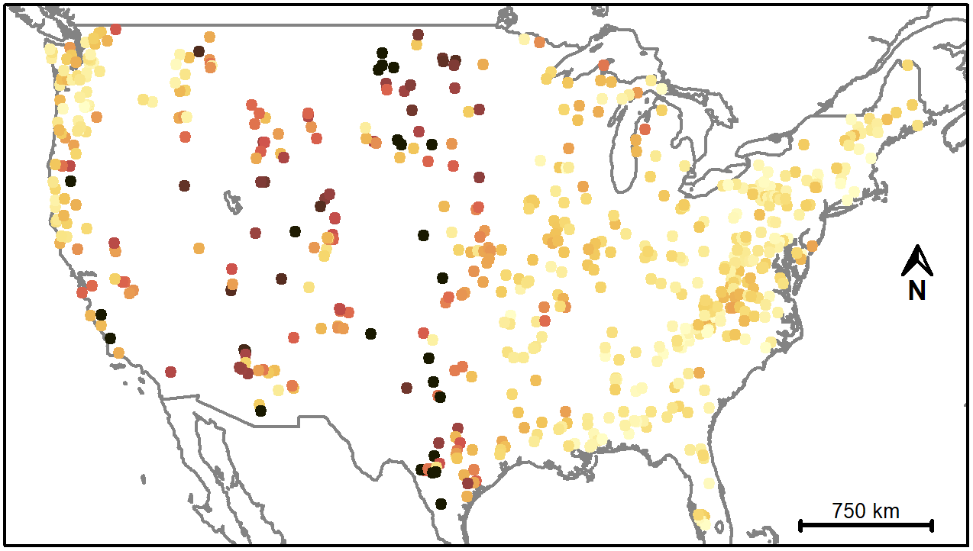
Results: difference to upper benchmark
?

Slide 30
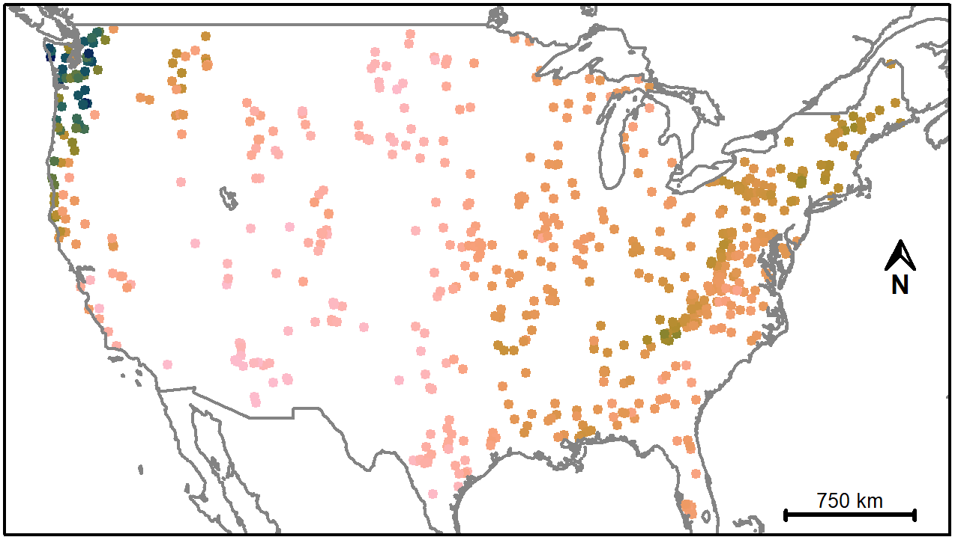
Aridity
?

Slide 31
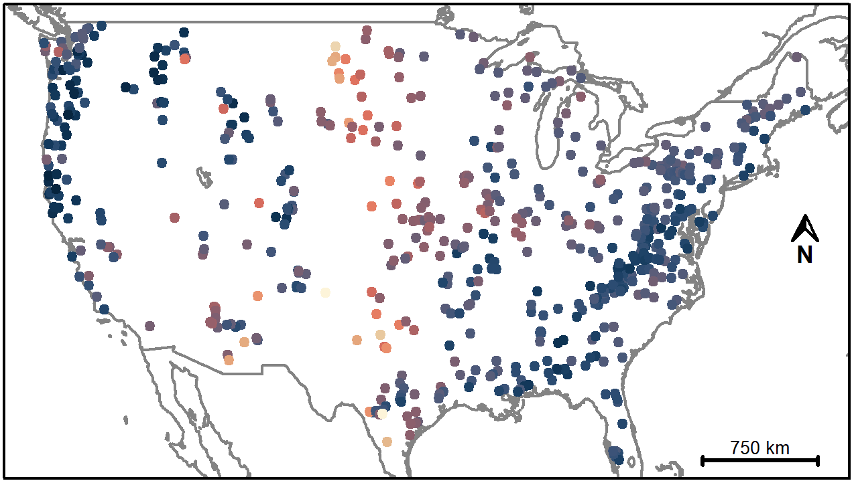
Results: ±20 % of the actual mean discharge
?

Slide 32
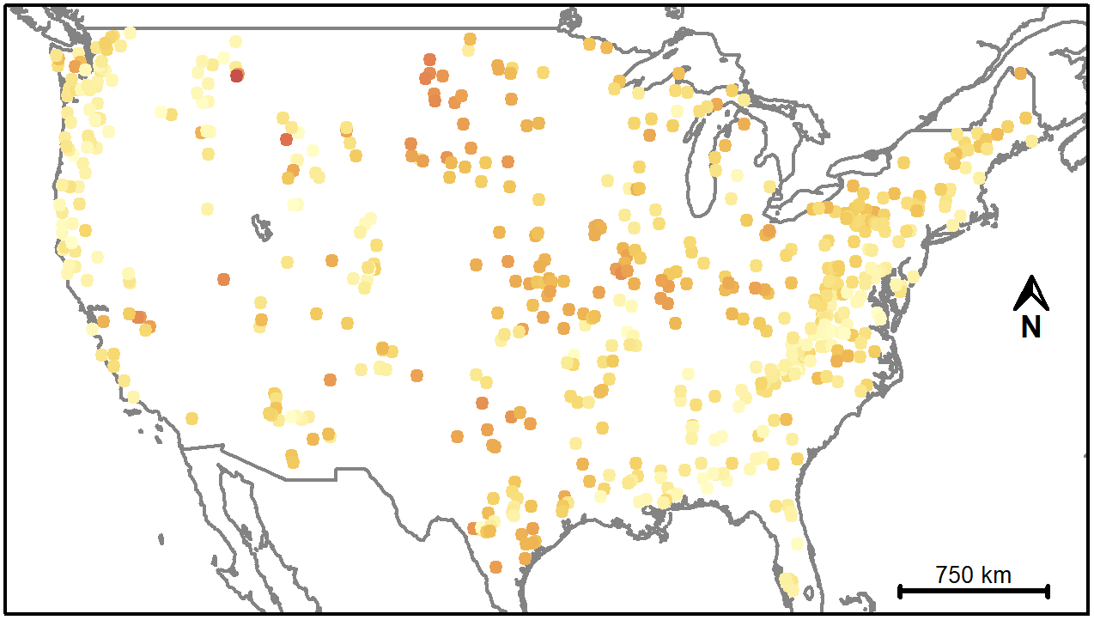
Results: difference to upper benchmark
?

Slide 33
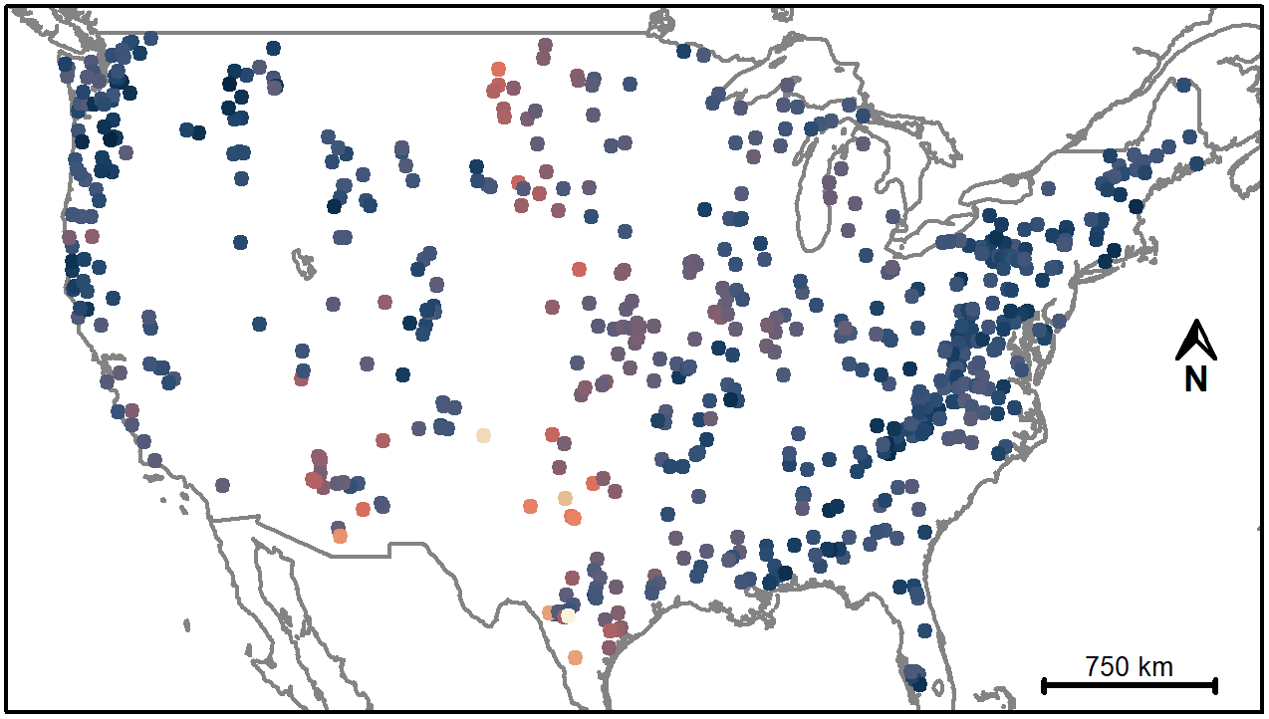
Results: daily stream levels and ±20 % of the mean discharge
?

Slide 34
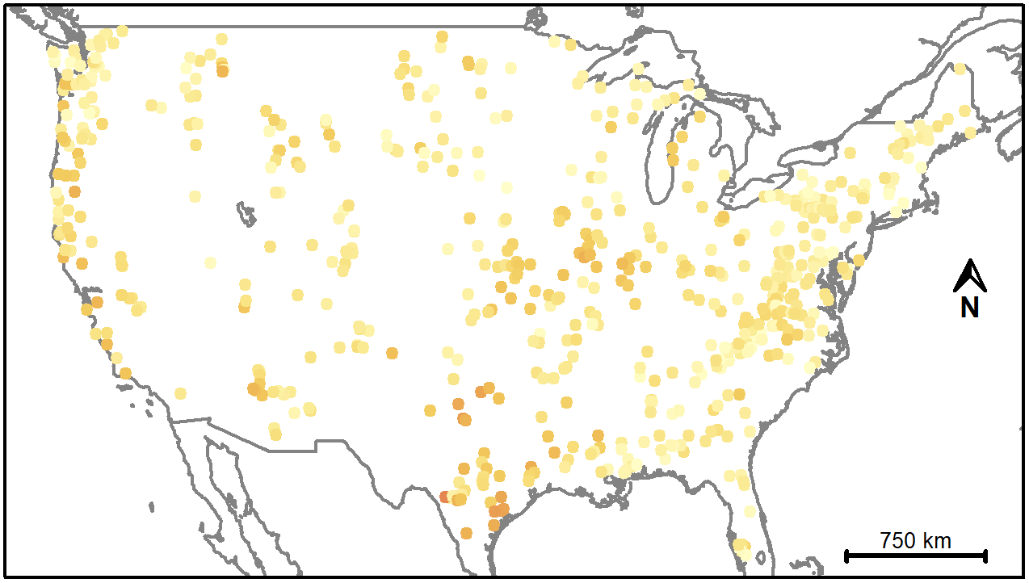
Results: difference to upper benchmark
?

Slide 35
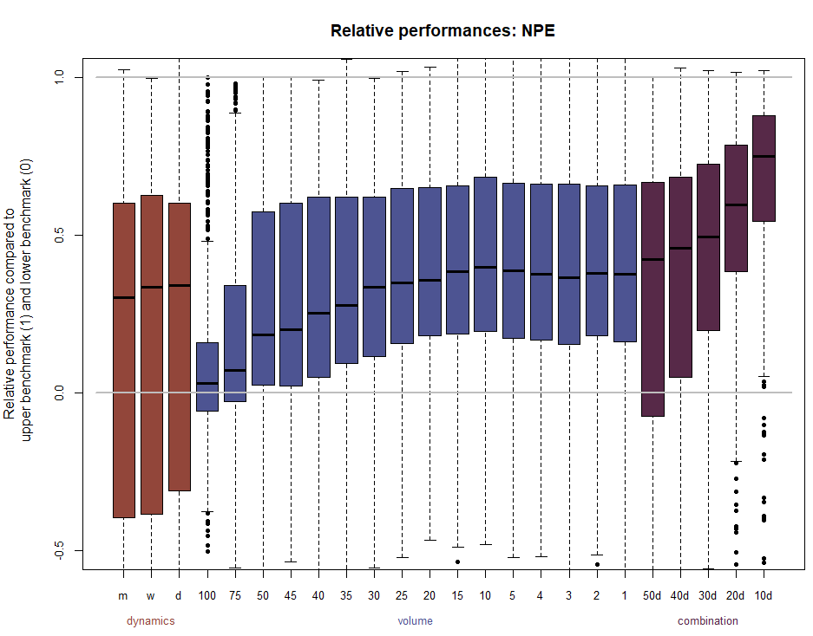
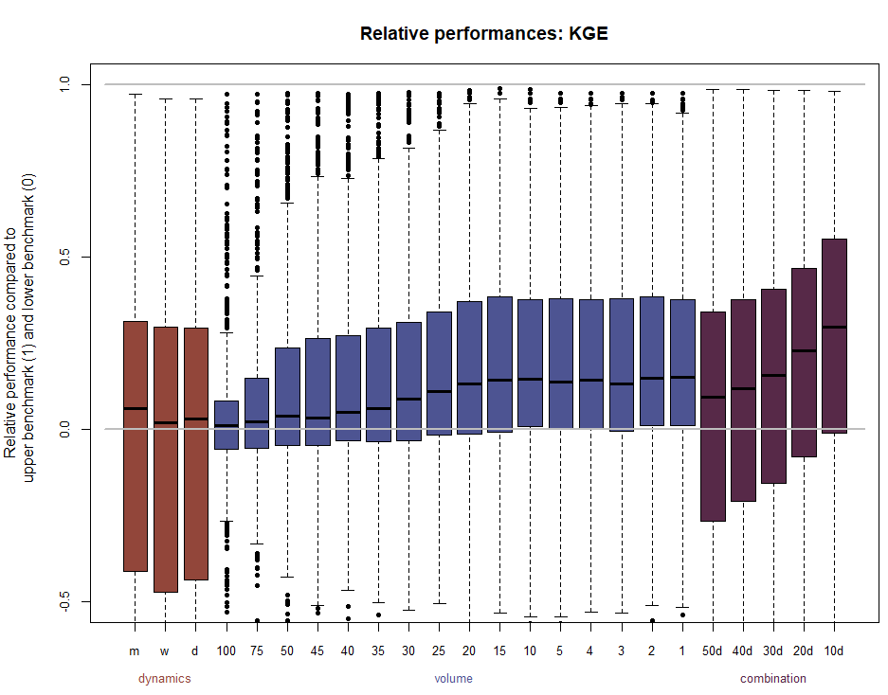
Dependence on objective function
?

Slide 36
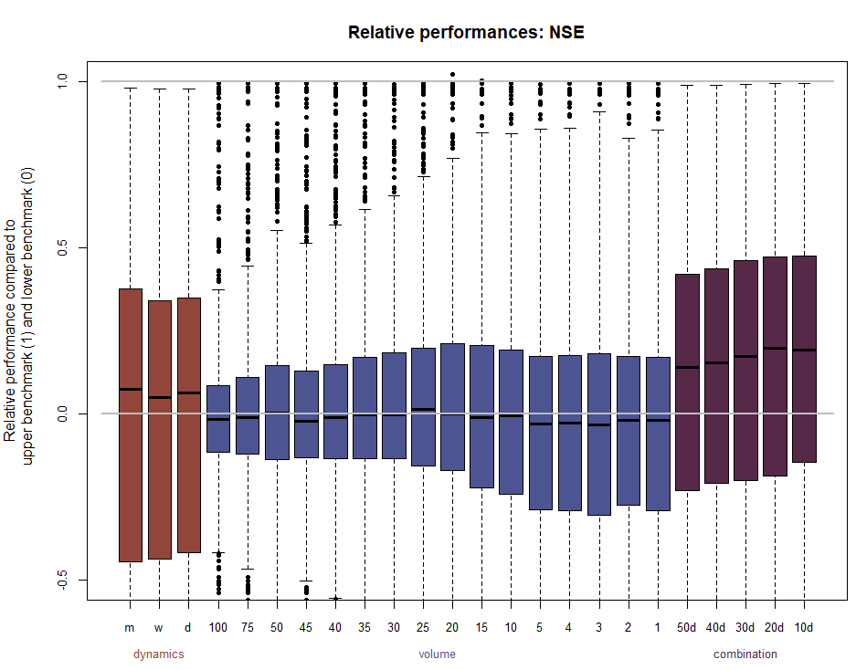
Dependence on objective function
?

Slide 37
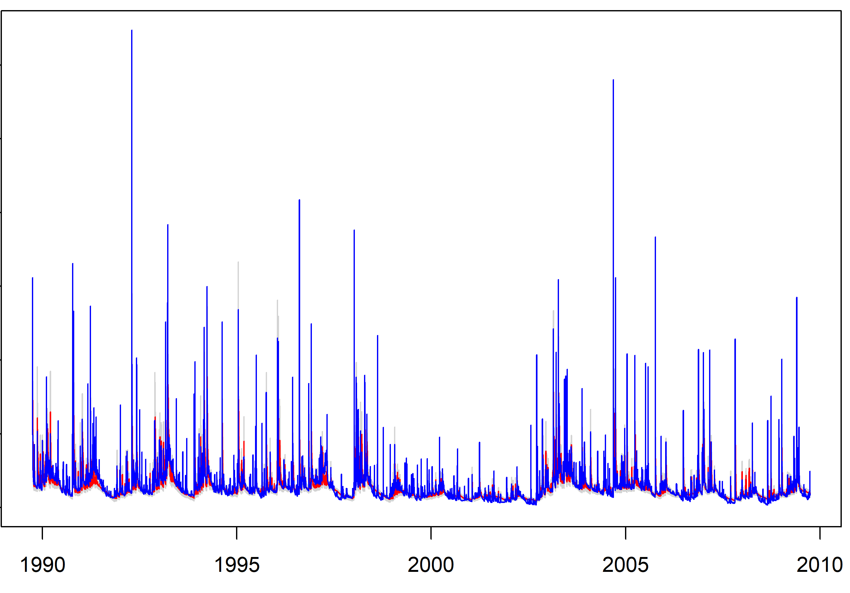
Simulated hydrographs: wet catchment
?
±20 %
daily stream levels
combination

Slide 38
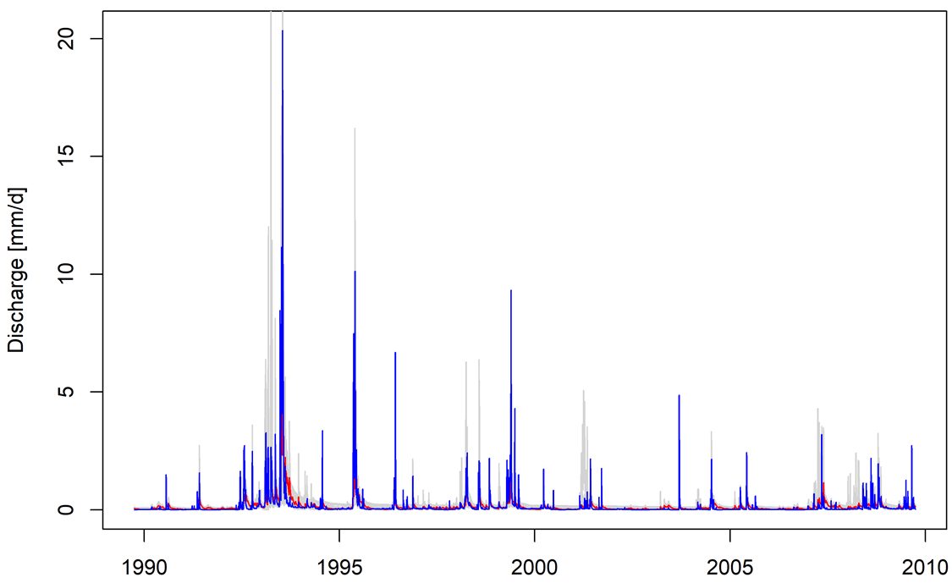
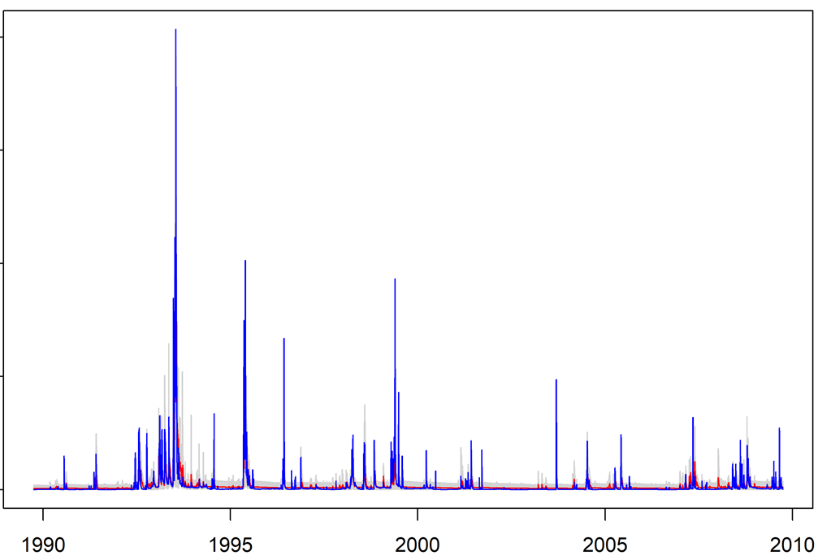
Simulated hydrographs: dry catchment
?
±20 %
daily stream levels
combination

Slide 39
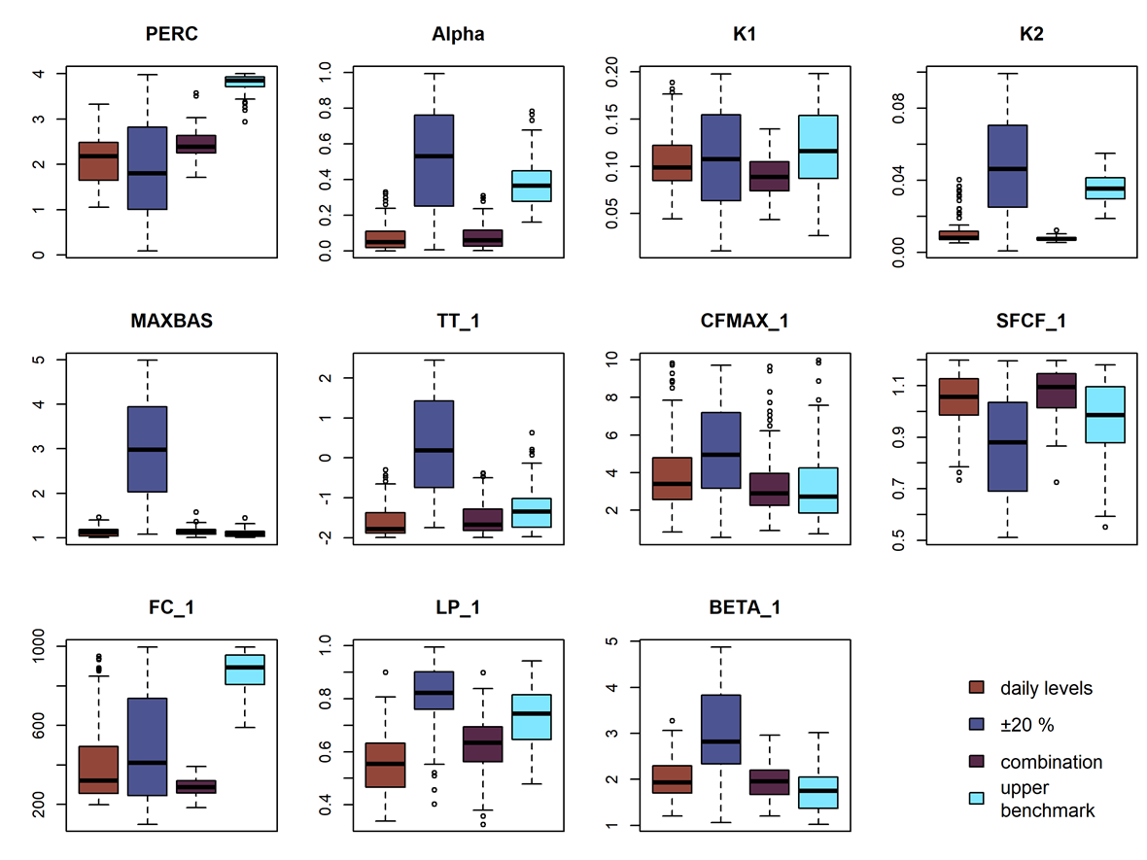
Constraining parameter values
?
Parameters tend to be more constrained by information on dynamics
Combination: similar parameters as for calibration on dynamics only
Upper benchmark (all discharge data) in general more similar to calibration on dynamics, but varying among parameters and catchments
(Example catchment)

Slide 40
Earlier use of mean discharge filter
?
Combination of
crowd-based waterlevel-class observations
a few discharge measurements
mean discharge filter
Deviation from the actual mean discharge of 2.5%, 5%, 10%, 20%, 30%, and 50% allowed
Clerc-Schwarzenbach et al. (in review):
Value of waterlevel-class observations for hydrological model calibration

Slide 41
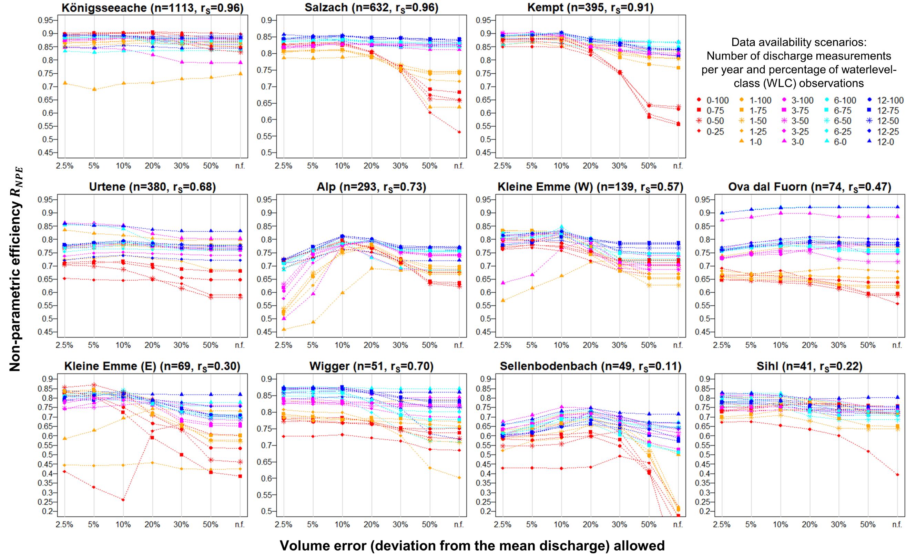
Results of all mean discharge filters
?
Positive effect on model performance
Especially valuable for scenarios without any volume information (red lines)
Narrower mean discharge constraint is not always better!
Clerc-Schwarzenbach et al. (in review):
Value of waterlevel-class observations for hydrological model calibration

Slide 42
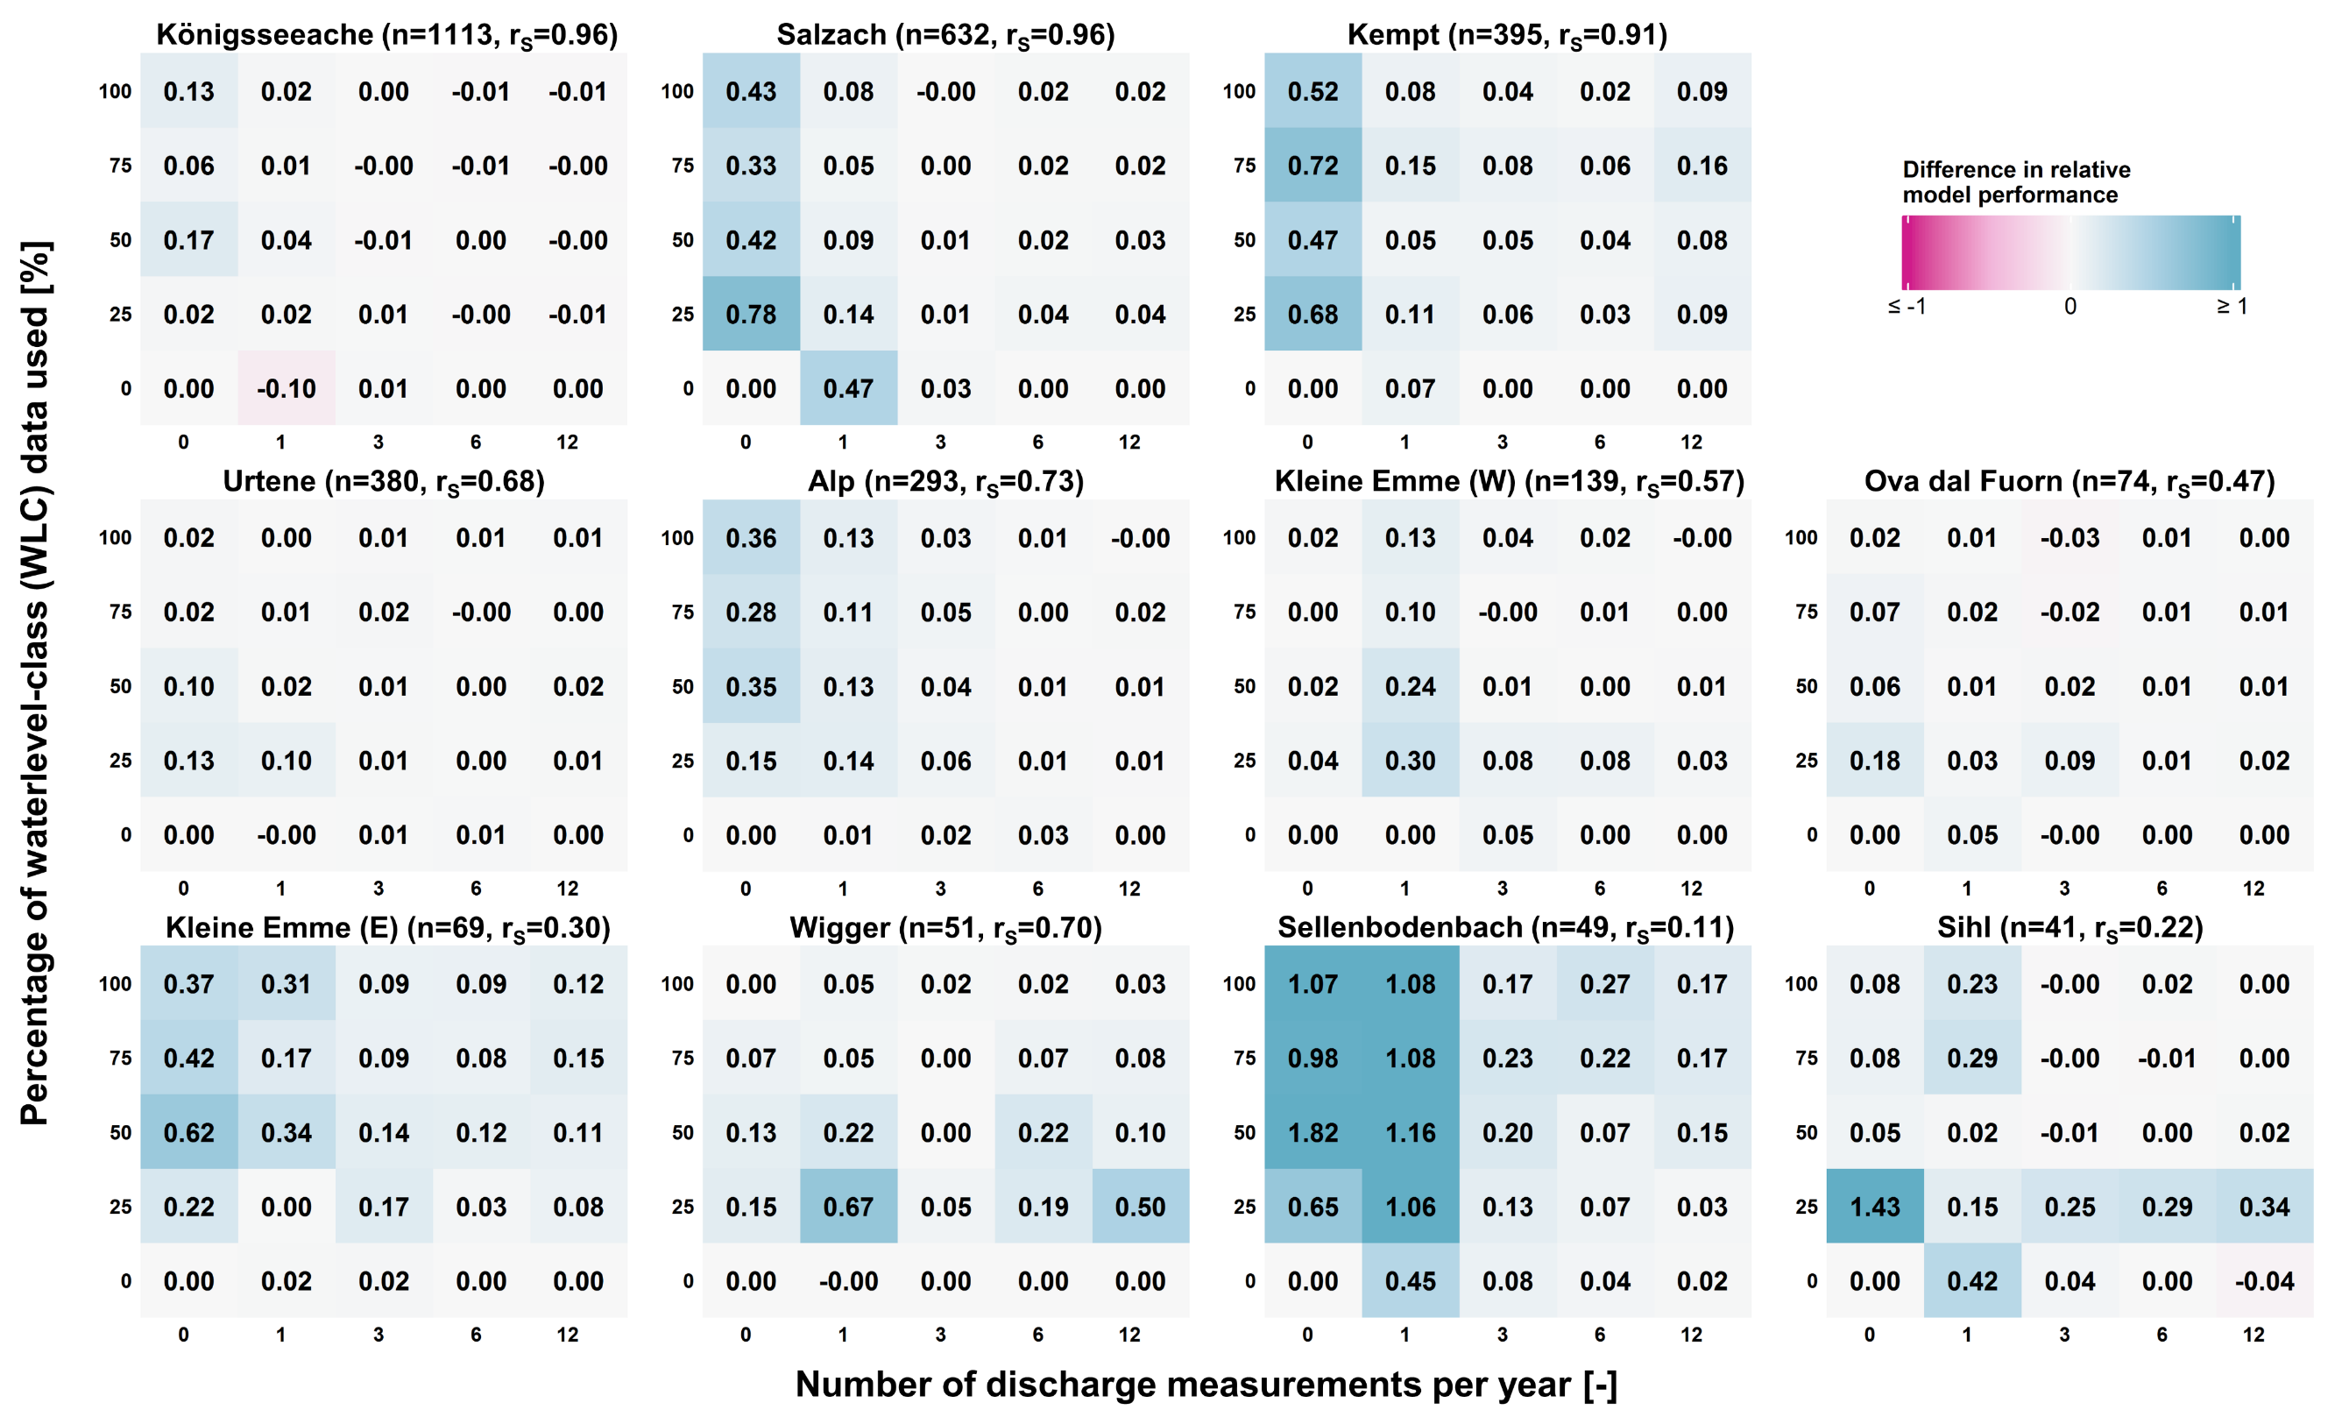
Effect of a mean discharge filter (± 30%)
?
Performance improved for (almost) all cases
Some volume information is highly valuable (major improvements when volume was lacking)
Scenarios with little room for improvement hardly profit from the additional constraint
Clerc-Schwarzenbach et al. (in review):
Value of waterlevel-class observations for hydrological model calibration

Slide 43
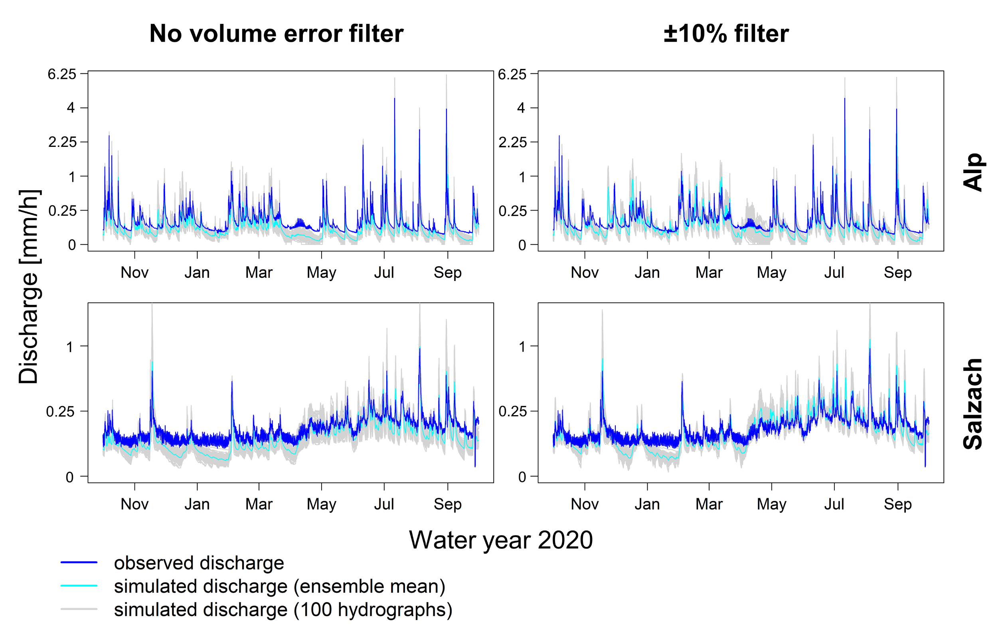
Hydrograph example
?
Filter reduced number of parameter sets that result in simulations with underestimate discharge
More parameter sets with higher simulated discharge improved ensemble mean performance
Clerc-Schwarzenbach et al. (in review):
Value of waterlevel-class observations for hydrological model calibration

Slide 44
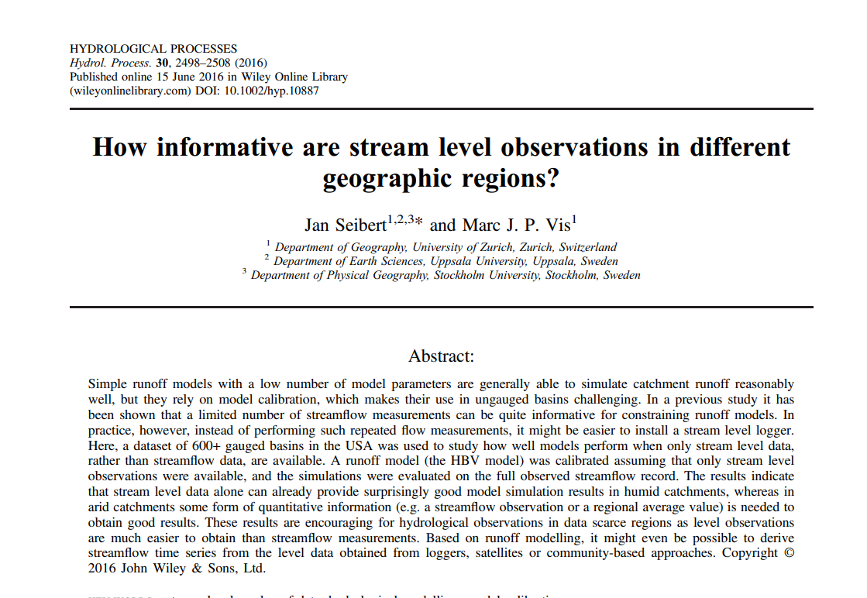
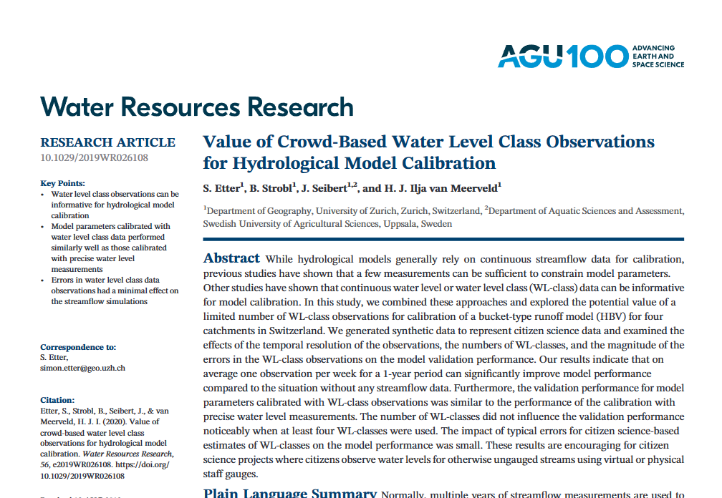
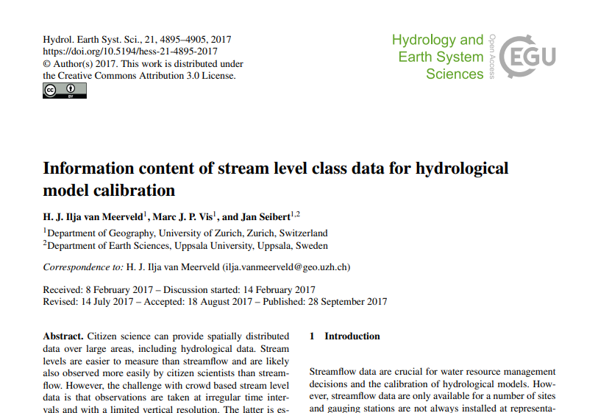
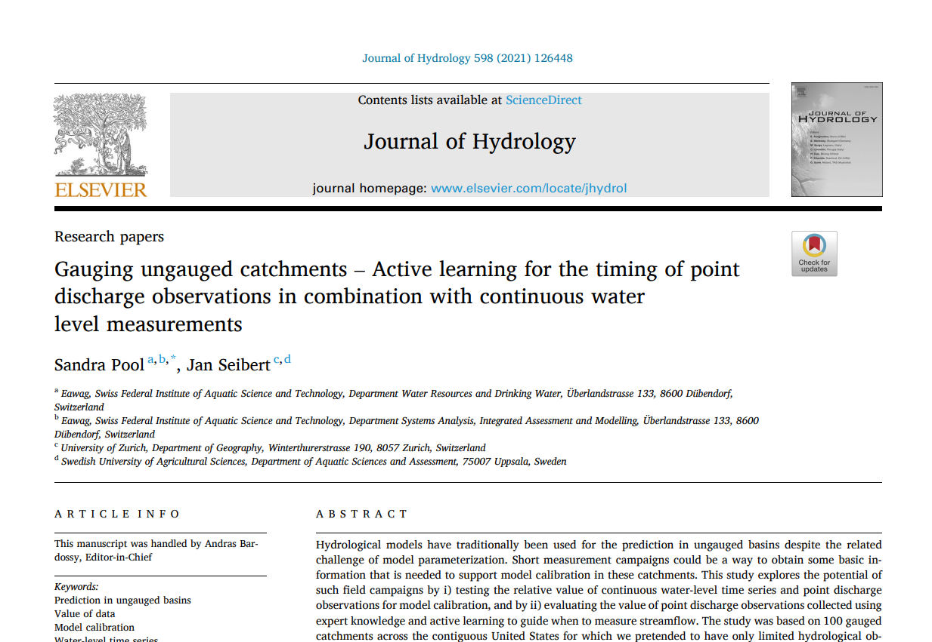
More results?
?
Visit Jan’s PICO next to me:
A few hundred catchments later – lessons learned from modeling large catchment samples

Slide 45
Literature
?
Clerc-Schwarzenbach, F. M., Seibert, J., Vis, M., & van Meerveld, I. (in review): Value of waterlevel-class observations for hydrological model calibration. Submitted to Hydrol. Sci. J. (on 05.03.2024).
Clerc-Schwarzenbach, F. M., Selleri, G., Neri, M., Toth, E., van Meerveld, I., & Seibert, J. (in review): HESS Opinions: A few camels or a whole caravan? Preprint, open for discussion (EGUsphere).
Seibert, J., Clerc-Schwarzenbach, F. M., & van Meerveld, H. J. I. (2024): Getting your money's worth: Testing the value of data for hydrological model calibration. Hydrol. Process., 38(2), e15094. doi:10.1002/hyp.15094
Seibert, J., Vis, M. J. P., Lewis, E., & van Meerveld, H. J. (2018): Upper and lower benchmarks in hydrological modelling. Hydrol. Process. 32, 1120-1125. doi:10.1002/hyp.11476

Slide 46
They check out CrowdWater ☺
?
You should do the same:
crowdwater.ch

Slide 47
?
Thank you for your evaluation and feedback!
franziska.clerc@geo.uzh.ch

